Slide 1
ENCOR
Special Feature Topics
[Your Name]
[Your Date]

Slide 2
ENCOR Special Feature Topics:
Click to select and jump* to the section:
ENCOR Enhanced Financial Report (Overview Version)
ENCOR Enhanced Financial Report (Detailed Version)
ENCOR A/R Module (Overview Version)
ENCOR A/R Module (Detailed Version)
NCR Platform Digital Receipts
Digital Coupons over NCR Platform with Inmar
FastLane Mobile Shopper
ENCOR Migration Tools
* Presentation must be in Slide Show mode
NCR Confidential
2

Slide 3
ENCOR Enhanced Financial Report (Overview Version)

Slide 4
Active Departments Only
Find
Compare
 |  |  |  | ENCOR Balancing Report
 |  |  |  | 4/24/2018 15:31
 |  |  |  | Store #1654
 | 4-22-2018 | 4-23-2018 | 4-24-2018 | 4-25-2018 | 4-26-2018 | 4-27-2018 | 4-28-2018
 | Monday | Tuesday | Wednesday | Thursday | Friday | Saturday | Sunday | Totals | GL Number
Sales
Department Sales | 0.00 | 0.00 | 0.00 | 0.00 | 0.00 | 0.00 | 0.00 | 0.00 | 12345
Sales Subtotal | 0.00 | 0.00 | 0.00 | 0.00 | 0.00 | 0.00 | 0.00 | 0.00
Tax | 0.00 | 0.00 | 0.00 | 0.00 | 0.00 | 0.00 | 0.00 | 0.00 | 23456
Total Sales Income | 0.00 | 0.00 | 0.00 | 0.00 | 0.00 | 0.00 | 0.00 | 0.00 | 123456
Misc Income
Misc Income 1 | 0.00 | 0.00 | 0.00 | 0.00 | 0.00 | 0.00 | 0.00 | 0.00
Misc Income 2 | 0.00 | 0.00 | 0.00 | 0.00 | 0.00 | 0.00 | 0.00 | 0.00
Misc Income 3 | 0.00 | 0.00 | 0.00 | 0.00 | 0.00 | 0.00 | 0.00 | 0.00
Misc Income 4 | 0.00 | 0.00 | 0.00 | 0.00 | 0.00 | 0.00 | 0.00 | 0.00
Total Misc Income | 0.00 | 0.00 | 0.00 | 0.00 | 0.00 | 0.00 | 0.00 | 0.00 | 99888
Office Misc Payments
Cash | 0.00 | 0.00 | 0.00 | 0.00 | 0.00 | 0.00 | 0.00 | 0.00
Total Office Misc Payments | 0.00 | 0.00 | 0.00 | 0.00 | 0.00 | 0.00 | 0.00 | 0.00
NCR Confidential
4
Notes:
The Financial Report application is a ad-hoc reporting engine that allows users to configure a spreadsheet view of financial figures. This gives the user the ability to review Income, Paid outs and Misc transactions. It uses a basic balancing algorithm to “balance” the financial totals from the POS.
The convergence of ScanMaster, ACS-IR and ISS45 has given us direction on feature sets that are needed.
This is not only a replacement for ScanMaster SRR and the ACS-IR DSR but an enhancement on those features.

Slide 5
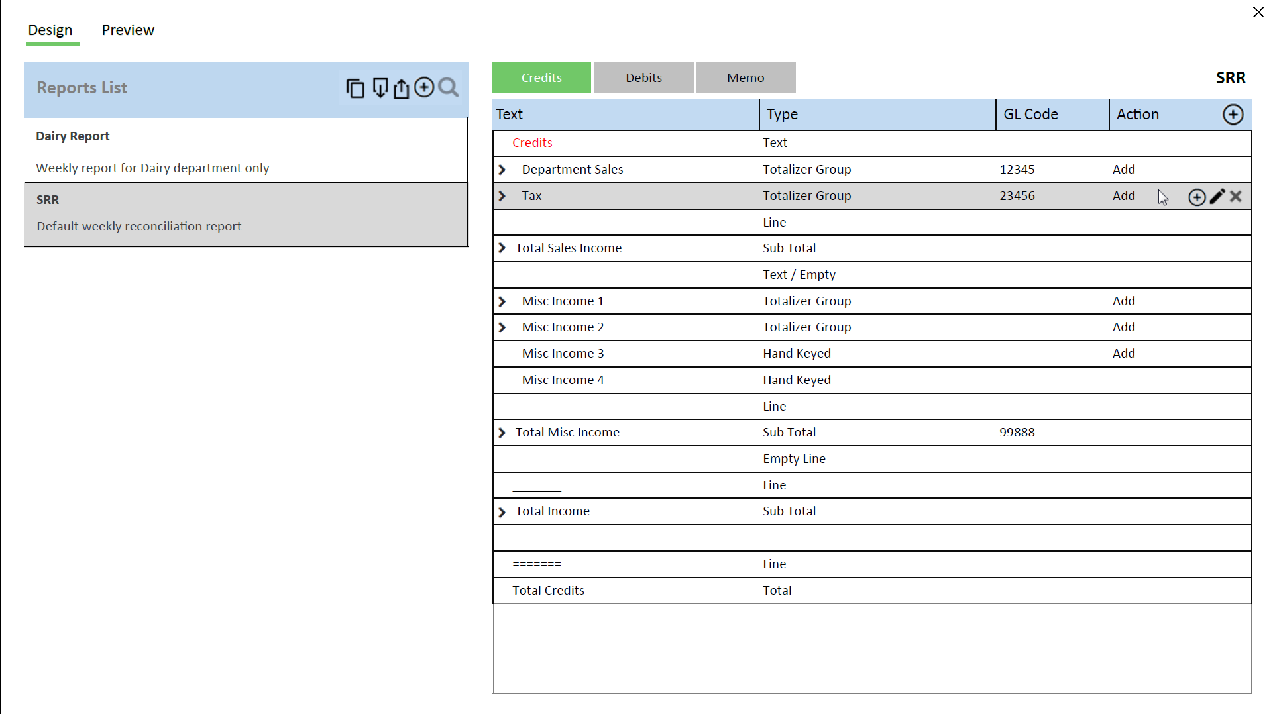
NCR Confidential
5
Notes:
We have designed it to be user defined. This allows users to change the report to fit accounting operations.
Template based allowing the user to define multiple reports.

Slide 6
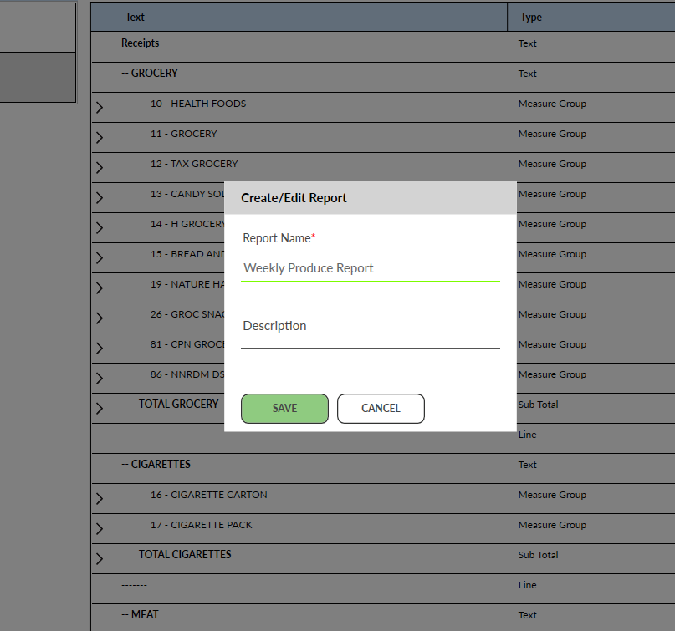
Financial Report Designer
NCR Confidential
6
Notes:
Create new reports, copy existing ones, or export and import existing ones.

Slide 7
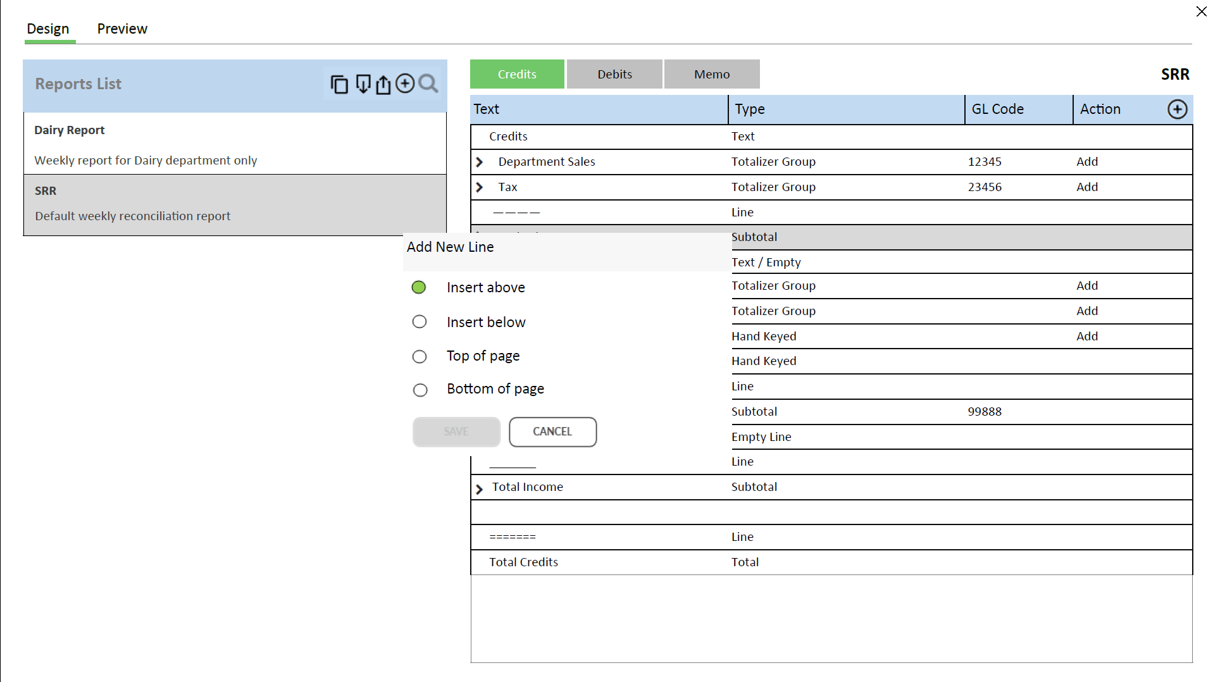
NCR Confidential
7
Notes:
One you have created a report. The Designer allows for user to add or remove financial figures.

Slide 8
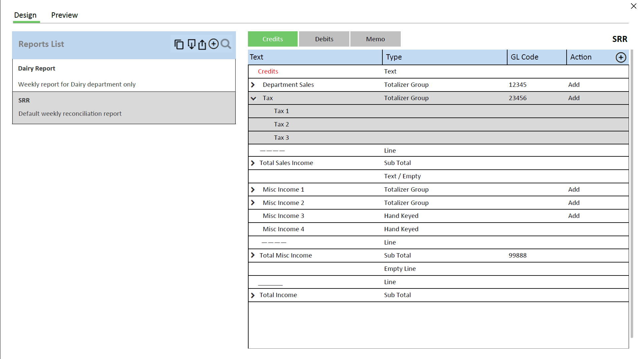
NCR Confidential
8
Notes:
Simple interface to allow technical and non technical resources the flexibility to define and customize specific reports.

Slide 9
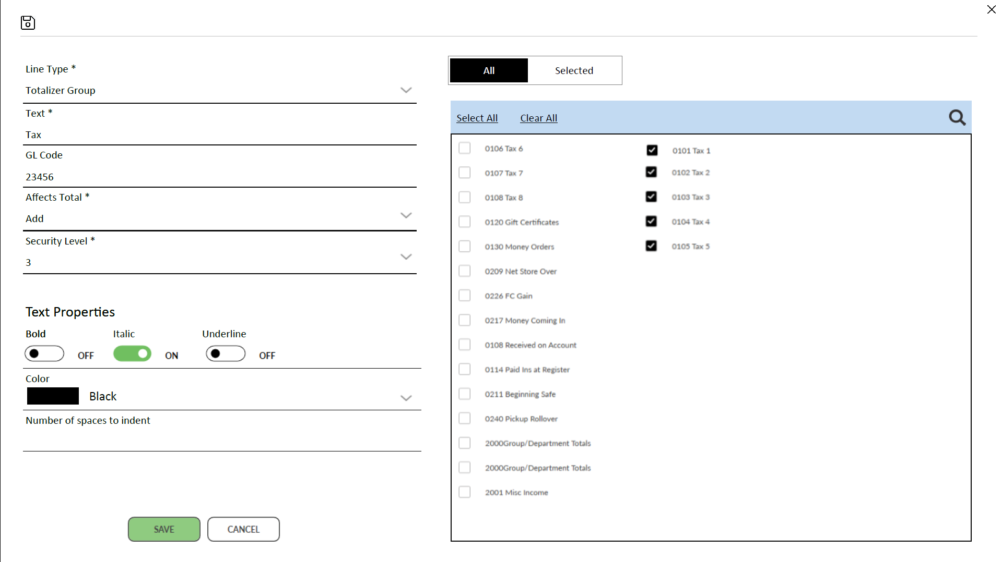
NCR Confidential
9
Notes:
The report is based on measures. Measures foundational elements captured by the POS system. An example would be departments. The system captures departments (net sales, voids, returns, ….) The designer allows users to use the measures to build reports based on how they want to view them. Consolidated or detailed.

Slide 10

Report List
Dairy Report Dairy departments only
ENCOR Balancing Report Default weekly reconciliation report
Period Options
Today | This Week | Last Week | Date Range
Department Options
All Departments | Active Only
Print Orientation
Landscape | Portrait
NCR Confidential
10
Notes:
Once the report is designed the user can view the report for current or historical dates.

Slide 11

Report List
Dairy Report Dairy departments only
ENCOR Balancing Report Default weekly reconciliation report
Period Options
Today | This Week | Last Week | Date Range
Group Sales By
Day | Week | Month
Start Date 1/1/2018
End Date 1/14/2018
Department Options
All Departments | Active Only
Print Orientation
Landscape | Portrait
NCR Confidential
11

Slide 12
Report List
Dairy Report Dairy departments only
ENCOR Balancing Report Default weekly reconciliation report
Period Options
Today | This Week | Last Week | Date Range
Group Sales By
Day | Week | Month
Start Week 1/1/2018
End Week 4/30/2018
Department Options
All Departments | Active Only
Print Orientation
Landscape | Portrait
NCR Confidential
12
Notes:
The report can be viewed as individual days or grouped into week or month aggregates.

Slide 13
Active Departments Only
Find
Compare
 |  |  |  | ENCOR Balancing Report
 |  |  |  | 4/24/2018 15:31
 |  |  |  | Store #1654
 | 4/1/2018- | 4/8/2018- | 4/15/2018- | 4/22/2018-
 | 4/7/2018 | 4/14/2018 | 4/21/2018 | 4/28/2018 | Totals | GL Number
Sales
Department Sales | 0.00 | 0.00 | 0.00 | 0.00 | 0.00 | 12345
Sales Subtotal | 0.00 | 0.00 | 0.00 | 0.00 | 0.00
Tax | 0.00 | 0.00 | 0.00 | 0.00 | 0.00 | 23456
Total Sales Income | 0.00 | 0.00 | 0.00 | 0.00 | 0.00 | 123456
Misc Income
Misc Income 1 | 0.00 | 0.00 | 0.00 | 0.00 | 0.00
Misc Income 2 | 0.00 | 0.00 | 0.00 | 0.00 | 0.00
Misc Income 3 | 0.00 | 0.00 | 0.00 | 0.00 | 0.00
Misc Income 4 | 0.00 | 0.00 | 0.00 | 0.00 | 0.00
Total Misc Income | 0.00 | 0.00 | 0.00 | 0.00 | 0.00 | 99888
Office Misc Payments
Cash | 0.00 | 0.00 | 0.00 | 0.00 | 0.00
Total Office Misc Payments | 0.00 | 0.00 | 0.00 | 0.00 | 0.00
NCR Confidential
13

Slide 14
THANK YOU
Return to Topics

Slide 15
ENCOR Enhanced Financial Report (Detailed Version)

Slide 16
Active Departments Only
Find
Compare
 |  |  |  | ENCOR Balancing Report
 |  |  |  | 4/24/2018 15:31
 |  |  |  | Store #1654
 | 4-22-2018 | 4-23-2018 | 4-24-2018 | 4-25-2018 | 4-26-2018 | 4-27-2018 | 4-28-2018
 | Monday | Tuesday | Wednesday | Thursday | Friday | Saturday | Sunday | Totals | GL Number
Sales
Department Sales | 0.00 | 0.00 | 0.00 | 0.00 | 0.00 | 0.00 | 0.00 | 0.00 | 12345
Sales Subtotal | 0.00 | 0.00 | 0.00 | 0.00 | 0.00 | 0.00 | 0.00 | 0.00
Tax | 0.00 | 0.00 | 0.00 | 0.00 | 0.00 | 0.00 | 0.00 | 0.00 | 23456
Total Sales Income | 0.00 | 0.00 | 0.00 | 0.00 | 0.00 | 0.00 | 0.00 | 0.00 | 123456
Misc Income
Misc Income 1 | 0.00 | 0.00 | 0.00 | 0.00 | 0.00 | 0.00 | 0.00 | 0.00
Misc Income 2 | 0.00 | 0.00 | 0.00 | 0.00 | 0.00 | 0.00 | 0.00 | 0.00
Misc Income 3 | 0.00 | 0.00 | 0.00 | 0.00 | 0.00 | 0.00 | 0.00 | 0.00
Misc Income 4 | 0.00 | 0.00 | 0.00 | 0.00 | 0.00 | 0.00 | 0.00 | 0.00
Total Misc Income | 0.00 | 0.00 | 0.00 | 0.00 | 0.00 | 0.00 | 0.00 | 0.00 | 99888
Office Misc Payments
Cash | 0.00 | 0.00 | 0.00 | 0.00 | 0.00 | 0.00 | 0.00 | 0.00
Total Office Misc Payments | 0.00 | 0.00 | 0.00 | 0.00 | 0.00 | 0.00 | 0.00 | 0.00
NCR Confidential
16
Notes:
The Financial Report application is a ad-hoc reporting engine that allows users to configure a spreadsheet view of financial figures. This gives the user the ability to review Income, Paid outs and Misc transactions. It uses a basic balancing algorithm to “balance” the financial totals from the POS.
The convergence of ScanMaster, ACS-IR and ISS45 has given us direction on feature sets that are needed.
This is not only a replacement for ScanMaster SRR and the ACS-IR DSR but an enhancement on those features.

Slide 17
NCR Confidential
17

Slide 18
NCR Confidential
18
Notes:
We have designed it to be user defined. This allows users to change the report to fit accounting operations.
Template based allowing the user to define multiple reports.

Slide 19
NCR Confidential
19
Notes:
Simple interface to allow technical and non technical resources the flexibility to define and customize specific reports.

Slide 20
NCR Confidential
20

Slide 21
Report List
Dairy Report Dairy departments only
ENCOR Balancing Report Default weekly reconciliation report
Period Options
Today | This Week | Last Week | Date Range
Department Options
All Departments | Active Only
Print Orientation
Landscape | Portrait
NCR Confidential
21

Slide 22

Report List
Dairy Report Dairy departments only
ENCOR Balancing Report Default weekly reconciliation report
Period Options
Today | This Week | Last Week | Date Range
Include Today
Department Options
All Departments | Active Only
Print Orientation
Landscape | Portrait
NCR Confidential
22

Slide 23
Report List
Dairy Report Dairy departments only
ENCOR Balancing Report Default weekly reconciliation report
Period Options
Today | This Week | Last Week | Date Range
Include Today
Department Options
All Departments | Active Only
Print Orientation
Landscape | Portrait
NCR Confidential
23

Slide 24
Report List
Dairy Report Dairy departments only
ENCOR Balancing Report Default weekly reconciliation report
Period Options
Today | This Week | Last Week | Date Range
Include Today
Department Options
All Departments | Active Only
Print Orientation
Landscape | Portrait
NCR Confidential
24

Slide 25
Report List
Dairy Report Dairy departments only
ENCOR Balancing Report Default weekly reconciliation report
Period Options
Today | This Week | Last Week | Date Range
Group Sales By
Day | Week | Month
Start Month
End Month
Department Options
All Departments | Active Only
Print Orientation
Landscape | Portrait
NCR Confidential
25

Slide 26
Report List
Dairy Report Dairy departments only
ENCOR Balancing Report Default weekly reconciliation report
Period Options
Today | This Week | Last Week | Date Range
Group Sales By
Day | Week | Month
Start Date 1/1/2018
End Date 1/14/2018
Department Options
All Departments | Active Only
Print Orientation
Landscape | Portrait
NCR Confidential
26

Slide 27
Report List
Dairy Report Dairy departments only
ENCOR Balancing Report Default weekly reconciliation report
Period Options
Today | This Week | Last Week | Date Range
Group Sales By
Day | Week | Month
Start Week 1/1/2018
End Week 4/30/2018
Department Options
All Departments | Active Only
Print Orientation
Landscape | Portrait
NCR Confidential
27

Slide 28
Report List
Dairy Report Dairy departments only
ENCOR Balancing Report Default weekly reconciliation report
Period Options
Today | This Week | Last Week | Date Range
Group Sales By
Day | Week | Month
Start Month 1/1/2018
End Month 4/30/2018
Department Options
All Departments | Active Only
Print Orientation
Landscape | Portrait
NCR Confidential
28

Slide 29

 | Compare To
 | Off | Last Month | Last Year
 | Show As
 | Percentage | Dollar Amount
NCR Confidential
29

Slide 30
Active Departments Only
Find
Compare
 |  |  |  |  |  |  | ENCOR Balancing Report
 |  |  |  |  |  |  | 4/24/2018 15:31
 |  |  |  |  |  |  | Store #1654
 | 4/22/2018 | 4/21/2017 | 4/23/2018 | 4/22/2017 | 4/24/2018 | 4/23/2017 | 4/25/2018 | 4/24/2017 | 4/26/2018 | 4/25/2017 | 4/27/2018 | 4/26/2017 | 4/28/2018 | 4/27/2017
 | Monday | Monday | Tuesday | Tuesday | Wednesday | Wednesday | Thursday | Thursday | Friday | Friday | Saturday | Saturday | Sunday | Sunday | Totals |  | GL Number
Sales
Department Sales | 0.00 | (0.00) | 0.00 | 0.00 | 0.00 | 0.00 | 0.00 | (0.00) | 0.00 | 0.00 | 0.00 | 0.00 | 0.00 | 0.00 | 0.00 | 0.00 | 12345
Sales Subtotal | 0.00 | (0.00) | 0.00 | 0.00 | 0.00 | 0.00 | 0.00 | (0.00) | 0.00 | 0.00 | 0.00 | 0.00 | 0.00 | 0.00 | 0.00 | 0.00
Tax | 0.00 | (0.00) | 0.00 | 0.00 | 0.00 | 0.00 | 0.00 | (0.00) | 0.00 | 0.00 | 0.00 | 0.00 | 0.00 | 0.00 | 0.00 | 0.00 | 23456
Total Sales Income | 0.00 | (0.00) | 0.00 | 0.00 | 0.00 | 0.00 | 0.00 | (0.00) | 0.00 | 0.00 | 0.00 | 0.00 | 0.00 | 0.00 | 0.00 | 0.00 | 123456
Misc Income
Misc Income 1 | 0.00 | (0.00) | 0.00 | 0.00 | 0.00 | 0.00 | 0.00 | (0.00) | 0.00 | 0.00 | 0.00 | 0.00 | 0.00 | 0.00 | 0.00 | 0.00
Misc Income 2 | 0.00 | (0.00) | 0.00 | 0.00 | 0.00 | 0.00 | 0.00 | (0.00) | 0.00 | 0.00 | 0.00 | 0.00 | 0.00 | 0.00 | 0.00 | 0.00
Misc Income 3 | 0.00 | (0.00) | 0.00 | 0.00 | 0.00 | 0.00 | 0.00 | (0.00) | 0.00 | 0.00 | 0.00 | 0.00 | 0.00 | 0.00 | 0.00 | 0.00
Misc Income 4 | 0.00 | (0.00) | 0.00 | 0.00 | 0.00 | 0.00 | 0.00 | (0.00) | 0.00 | 0.00 | 0.00 | 0.00 | 0.00 | 0.00 | 0.00 | 0.00
Total Misc Income | 0.00 | (0.00) | 0.00 | 0.00 | 0.00 | 0.00 | 0.00 | (0.00) | 0.00 | 0.00 | 0.00 | 0.00 | 0.00 | 0.00 | 0.00 | 0.00 | 99888
Office Misc Payments
Cash | 0.00 | (0.00) | 0.00 | 0.00 | 0.00 | 0.00 | 0.00 | (0.00) | 0.00 | 0.00 | 0.00 | 0.00 | 0.00 | 0.00 | 0.00 | 0.00
Total Office Misc Payments | 0.00 | (0.00) | 0.00 | 0.00 | 0.00 | 0.00 | 0.00 | (0.00) | 0.00 | 0.00 | 0.00 | 0.00 | 0.00 | 0.00 | 0.00 | 0.00
NCR Confidential
30

Slide 31
Active Departments Only
Find
Compare
 |  |  |  | ENCOR Balancing Report
 |  |  |  | 4/24/2018 15:31
 |  |  |  | Store #1654
 | 4/1/2018- | 4/8/2018- | 4/15/2018- | 4/22/2018-
 | 4/7/2018 | 4/14/2018 | 4/21/2018 | 4/28/2018 | Totals | GL Number
Sales
Department Sales | 0.00 | 0.00 | 0.00 | 0.00 | 0.00 | 12345
Sales Subtotal | 0.00 | 0.00 | 0.00 | 0.00 | 0.00
Tax | 0.00 | 0.00 | 0.00 | 0.00 | 0.00 | 23456
Total Sales Income | 0.00 | 0.00 | 0.00 | 0.00 | 0.00 | 123456
Misc Income
Misc Income 1 | 0.00 | 0.00 | 0.00 | 0.00 | 0.00
Misc Income 2 | 0.00 | 0.00 | 0.00 | 0.00 | 0.00
Misc Income 3 | 0.00 | 0.00 | 0.00 | 0.00 | 0.00
Misc Income 4 | 0.00 | 0.00 | 0.00 | 0.00 | 0.00
Total Misc Income | 0.00 | 0.00 | 0.00 | 0.00 | 0.00 | 99888
Office Misc Payments
Cash | 0.00 | 0.00 | 0.00 | 0.00 | 0.00
Total Office Misc Payments | 0.00 | 0.00 | 0.00 | 0.00 | 0.00
NCR Confidential
31

Slide 32
 | Compare To
 | Off | Last Year
 | Show As
 | Percentage | Dollar Amount
NCR Confidential
32

Slide 33
Active Departments Only
Find
Compare
 |  |  |  |  |  |  | ENCOR Balancing Report
 |  |  |  |  |  |  | 4/24/2018 15:31
 |  |  |  |  |  |  | Store #1654
 | 4/1/2018- | 4/2/2017- | 4/8/2018- | 4/9/2017- | 4/15/2018- | 4/16/2017- | 4/22/2018- | 4/23/2017-
 | 4/7/2018 | 4/8/2017 | 4/14/2018 | 4/15/2017 | 4/21/2018 | 4/22/2017 | 4/28/2018 | 4/29/2017 | Totals |  | GL Number
Sales
Department Sales | 0.00 | (0.00) | 0.00 | 0.00 | 0.00 | 0.00 | 0.00 | 0.00 | 0.00 | 0.00 | 12345
Sales Subtotal | 0.00 | (0.00) | 0.00 | 0.00 | 0.00 | 0.00 | 0.00 | 0.00 | 0.00 | 0.00
Tax | 0.00 | (0.00) | 0.00 | 0.00 | 0.00 | 0.00 | 0.00 | 0.00 | 0.00 | 0.00 | 23456
Total Sales Income | 0.00 | (0.00) | 0.00 | 0.00 | 0.00 | 0.00 | 0.00 | 0.00 | 0.00 | 0.00 | 123456
Misc Income
Misc Income 1 | 0.00 | (0.00) | 0.00 | 0.00 | 0.00 | 0.00 | 0.00 | 0.00 | 0.00 | 0.00
Misc Income 2 | 0.00 | (0.00) | 0.00 | 0.00 | 0.00 | 0.00 | 0.00 | 0.00 | 0.00 | 0.00
Misc Income 3 | 0.00 | (0.00) | 0.00 | 0.00 | 0.00 | 0.00 | 0.00 | 0.00 | 0.00 | 0.00
Misc Income 4 | 0.00 | (0.00) | 0.00 | 0.00 | 0.00 | 0.00 | 0.00 | 0.00 | 0.00 | 0.00
Total Misc Income | 0.00 | (0.00) | 0.00 | 0.00 | 0.00 | 0.00 | 0.00 | 0.00 | 0.00 | 0.00 | 99888
Office Misc Payments
Cash | 0.00 | (0.00) | 0.00 | 0.00 | 0.00 | 0.00 | 0.00 | 0.00 | 0.00 | 0.00
Total Office Misc Payments | 0.00 | (0.00) | 0.00 | 0.00 | 0.00 | 0.00 | 0.00 | 0.00 | 0.00 | 0.00
NCR Confidential
33

Slide 34
Active Departments Only
Find
Compare
 |  |  |  |  |  |  | ENCOR Balancing Report
 |  |  |  |  |  |  | 4/24/2018 15:31
 |  |  |  |  |  |  | Store #1654
 | 4/1/2018- | 4/2/2017- | 4/8/2018- | 4/9/2017- | 4/15/2018- | 4/16/2017- | 4/22/2018- | 4/23/2017-
 | 4/7/2018 | 4/8/2017 | 4/14/2018 | 4/15/2017 | 4/21/2018 | 4/22/2017 | 4/28/2018 | 4/29/2017 | Totals |  | GL Number
Sales
Department Sales | 0.00 | (0.00) | 0.00 | 0.00 | 0.00 | 0.00 | 0.00 | 0.00 | 0.00 | 0.00 | 12345
Sales Subtotal | 0.00 | (0.00) | 0.00 | 0.00 | 0.00 | 0.00 | 0.00 | 0.00 | 0.00 | 0.00
Tax | 0.00 | (0.00) | 0.00 | 0.00 | 0.00 | 0.00 | 0.00 | 0.00 | 0.00 | 0.00 | 23456
Total Sales Income | 0.00 | (0.00) | 0.00 | 0.00 | 0.00 | 0.00 | 0.00 | 0.00 | 0.00 | 0.00 | 123456
Misc Income
Misc Income 1 | 0.00 | (0.00) | 0.00 | 0.00 | 0.00 | 0.00 | 0.00 | 0.00 | 0.00 | 0.00
Misc Income 2 | 0.00 | (0.00) | 0.00 | 0.00 | 0.00 | 0.00 | 0.00 | 0.00 | 0.00 | 0.00
Misc Income 3 | 0.00 | (0.00) | 0.00 | 0.00 | 0.00 | 0.00 | 0.00 | 0.00 | 0.00 | 0.00
Misc Income 4 | 0.00 | (0.00) | 0.00 | 0.00 | 0.00 | 0.00 | 0.00 | 0.00 | 0.00 | 0.00
Total Misc Income | 0.00 | (0.00) | 0.00 | 0.00 | 0.00 | 0.00 | 0.00 | 0.00 | 0.00 | 0.00 | 99888
Office Misc Payments
Cash | 0.00 | (0.00) | 0.00 | 0.00 | 0.00 | 0.00 | 0.00 | 0.00 | 0.00 | 0.00
Total Office Misc Payments | 0.00 | (0.00) | 0.00 | 0.00 | 0.00 | 0.00 | 0.00 | 0.00 | 0.00 | 0.00
NCR Confidential
34

Slide 35
99888 1/1
Active Departments Only
Find
Compare
 |  |  |  |  |  |  | ENCOR Balancing Report
 |  |  |  |  |  |  | 4/24/2018 15:31
 |  |  |  |  |  |  | Store #1654
 | 4/1/2018- | 4/2/2017- | 4/8/2018- | 4/9/2017- | 4/15/2018- | 4/16/2017- | 4/22/2018- | 4/23/2017-
 | 4/7/2018 | 4/8/2017 | 4/14/2018 | 4/15/2017 | 4/21/2018 | 4/22/2017 | 4/28/2018 | 4/29/2017 | Totals |  | GL Number
Sales
Department Sales | 0.00 | (0.00) | 0.00 | 0.00 | 0.00 | 0.00 | 0.00 | 0.00 | 0.00 | 0.00 | 12345
Sales Subtotal | 0.00 | (0.00) | 0.00 | 0.00 | 0.00 | 0.00 | 0.00 | 0.00 | 0.00 | 0.00
Tax | 0.00 | (0.00) | 0.00 | 0.00 | 0.00 | 0.00 | 0.00 | 0.00 | 0.00 | 0.00 | 23456
Total Sales Income | 0.00 | (0.00) | 0.00 | 0.00 | 0.00 | 0.00 | 0.00 | 0.00 | 0.00 | 0.00 | 123456
Misc Income
Misc Income 1 | 0.00 | (0.00) | 0.00 | 0.00 | 0.00 | 0.00 | 0.00 | 0.00 | 0.00 | 0.00
Misc Income 2 | 0.00 | (0.00) | 0.00 | 0.00 | 0.00 | 0.00 | 0.00 | 0.00 | 0.00 | 0.00
Misc Income 3 | 0.00 | (0.00) | 0.00 | 0.00 | 0.00 | 0.00 | 0.00 | 0.00 | 0.00 | 0.00
Misc Income 4 | 0.00 | (0.00) | 0.00 | 0.00 | 0.00 | 0.00 | 0.00 | 0.00 | 0.00 | 0.00
Total Misc Income | 0.00 | (0.00) | 0.00 | 0.00 | 0.00 | 0.00 | 0.00 | 0.00 | 0.00 | 0.00 | 99888
Office Misc Payments
Cash | 0.00 | (0.00) | 0.00 | 0.00 | 0.00 | 0.00 | 0.00 | 0.00 | 0.00 | 0.00
Total Office Misc Payments | 0.00 | (0.00) | 0.00 | 0.00 | 0.00 | 0.00 | 0.00 | 0.00 | 0.00 | 0.00
NCR Confidential
35

Slide 36
Active Departments Only
Find
Compare
 |  |  |  | ENCOR Balancing Report
 |  |  |  | 4/24/2018 15:31
 |  |  |  | Store #1654
 | Jan-18 | Feb-18 | Mar-18 | Apr-18 | Totals | GL Number
Sales
Department Sales | 0.00 | 0.00 | 0.00 | 0.00 | 0.00 | 12345
Sales Subtotal | 0.00 | 0.00 | 0.00 | 0.00 | 0.00
Tax | 0.00 | 0.00 | 0.00 | 0.00 | 0.00 | 23456
Total Sales Income | 0.00 | 0.00 | 0.00 | 0.00 | 0.00 | 123456
Misc Income
Misc Income 1 | 0.00 | 0.00 | 0.00 | 0.00 | 0.00
Misc Income 2 | 0.00 | 0.00 | 0.00 | 0.00 | 0.00
Misc Income 3 | 0.00 | 0.00 | 0.00 | 0.00 | 0.00
Misc Income 4 | 0.00 | 0.00 | 0.00 | 0.00 | 0.00
Total Misc Income | 0.00 | 0.00 | 0.00 | 0.00 | 0.00 | 99888
Office Misc Payments
Cash | 0.00 | 0.00 | 0.00 | 0.00 | 0.00
Total Office Misc Payments | 0.00 | 0.00 | 0.00 | 0.00 | 0.00
NCR Confidential
36

Slide 37
 | Compare To
 | Off | Last Year
 | Show As
 | Percentage | Dollar Amount
NCR Confidential
37

Slide 38
Active Departments Only
Find
Compare
 |  |  |  | ENCOR Balancing Report
 |  |  |  | 4/24/2018 15:31
 |  |  |  | Store #1654
 | Jan-18 | Jan-17 | Feb-18 | Feb-17 | Mar-18 | Mar-17 | Apr-18 | Apr-17 | Totals |  | GL Number
Sales
Department Sales | 0.00 | 0.00 | 0.00 | (0.00) | 0.00 | 0.00 | 0.00 | 0.00 | 0.00 | 0.00 | 12345
Sales Subtotal | 0.00 | 0.00 | 0.00 | (0.00) | 0.00 | 0.00 | 0.00 | 0.00 | 0.00 | 0.00
Tax | 0.00 | 0.00 | 0.00 | (0.00) | 0.00 | 0.00 | 0.00 | 0.00 | 0.00 | 0.00 | 23456
Total Sales Income | 0.00 | 0.00 | 0.00 | (0.00) | 0.00 | 0.00 | 0.00 | 0.00 | 0.00 | 0.00 | 123456
Misc Income
Misc Income 1 | 0.00 | 0.00 | 0.00 | (0.00) | 0.00 | 0.00 | 0.00 | 0.00 | 0.00 | 0.00
Misc Income 2 | 0.00 | 0.00 | 0.00 | (0.00) | 0.00 | 0.00 | 0.00 | 0.00 | 0.00 | 0.00
Misc Income 3 | 0.00 | 0.00 | 0.00 | (0.00) | 0.00 | 0.00 | 0.00 | 0.00 | 0.00 | 0.00
Misc Income 4 | 0.00 | 0.00 | 0.00 | (0.00) | 0.00 | 0.00 | 0.00 | 0.00 | 0.00 | 0.00
Total Misc Income | 0.00 | 0.00 | 0.00 | (0.00) | 0.00 | 0.00 | 0.00 | 0.00 | 0.00 | 0.00 | 99888
Office Misc Payments
Cash | 0.00 | 0.00 | 0.00 | (0.00) | 0.00 | 0.00 | 0.00 | 0.00 | 0.00 | 0.00
Total Office Misc Payments | 0.00 | 0.00 | 0.00 | (0.00) | 0.00 | 0.00 | 0.00 | 0.00 | 0.00 | 0.00
NCR Confidential
38

Slide 39
THANK YOU
Return to Topics

Slide 40
ENCOR A/R Module (Overview Version)

Slide 41
Accounts Receivable
Based on ACS-IR A/R module
AR End of Month
Adjustments / Charges / Payments
Aging Report / Activity Report
AR Statement
AR Statement Option
AR Status
AR Tender Types
Customer Account Maintenance
Customer Account Merge
NCR Confidential
41

Slide 42



Customers
[Id between (41999900000 and 49999900000)]
41999900001 Toby Hughes 530-710-3668 4361 Clement Street Atlanta GA 55805
41999900002 Larry Simon 152-351-3253 2084 Junior Avenue Atlanta GA 55805
41999900003 Steven Austin 789-258-7894 1496 Jones Street Atlanta GA 55805
41999900004 Tomas Ward 439-896-1921 4616 Felosa Drive Atlanta GA 55805
41999900005 Arnold Brock 107-632-3651 952 Leverton Cove Road Atlanta GA 55805
41999900006 Samantha Moore 809-400-7045 1139 Steele Street Atlanta GA 55805
41999900007 Maryann Matthews 978-679-9404 3473 Sunset Drive Atlanta GA 55805
Customer Data
Charge
Customer #* 41999900001
Country USA
First Name Toby
State GA
Zip Code 55805
Last Name Hughes
Tax Exempt # 5466878
Phone 1 530-710-3668
Aux Field
Phone 2
Comments NSF $38.26 4/17/2017
Address 1 4361 Clement Street
External Reference #
Address 2
Employee
City Atlanta
Charge
NCR Confidential
42
Notes:
Customer information

Slide 43
Customers
[Id between (41999900000 and 49999900000)]
41999900001 Toby Hughes 530-710-3668 4361 Clement Street Atlanta GA 55805
41999900002 Larry Simon 152-351-3253 2084 Junior Avenue Atlanta GA 55805
41999900003 Steven Austin 789-258-7894 1496 Jones Street Atlanta GA 55805
41999900004 Tomas Ward 439-896-1921 4616 Felosa Drive Atlanta GA 55805
41999900005 Arnold Brock 107-632-3651 952 Leverton Cove Road Atlanta GA 55805
41999900006 Samantha Moore 809-400-7045 1139 Steele Street Atlanta GA 55805
41999900007 Maryann Matthews 978-679-9404 3473 Sunset Drive Atlanta GA 55805
Customer Data
Charge
Date Opened 4/25/2009
APR %
Credit Limit 150.00
Finance Charge
Last Payment 2/15/2018
Compound Charges
Current Balance 79.86
Charge Status
NCR Confidential
43
Notes:
AR specific information

Slide 44

Customers
Search by Customer #, Last Name or Phone #
Customer Data
Charge
Add Customer
Create Single Customer Account
Create Range of Customer Accounts
From Customer #
To Customer #
Country
Customer #
First Name
State
Zip Code
Last Name
Tax Exempt #
Phone 1
Aux Field
Phone 2
Comments
Address 1
External Reference #
Address 2
Employee
OFF
City
Charge
OFF
NCR Confidential
44
Notes:
Create by range or individual

Slide 45

Source Customer
[Id between (41999900000 and 49999900000)]
41999900001 Toby Hughes 530-710-3668 4361 Clement Street Atlanta GA 55805
41999900002 Larry Simon 152-351-3253 2084 Junior Avenue Atlanta GA 55805
41999900003 Steven Austin 789-258-7894 1496 Jones Street Atlanta GA 55805
41999900004 Tomas Ward 439-896-1921 4616 Felosa Drive Atlanta GA 55805
41999900005 Arnold Brock 107-632-3651 952 Leverton Cove Road Atlanta GA 55805
41999900006 Samantha Moore 809-400-7045 1139 Steele Street Atlanta GA 55805
Destination Customer
[Id between (41999900000 and 49999900000)]
41999900001 Toby Hughes 530-710-3668 4361 Clement Street Atlanta GA 55805
41999900002 Larry Simon 152-351-3253 2084 Junior Avenue Atlanta GA 55805
41999900003 Steven Austin 789-258-7894 1496 Jones Street Atlanta GA 55805
41999900004 Tomas Ward 439-896-1921 4616 Felosa Drive Atlanta GA 55805
41999900005 Arnold Brock 107-632-3651 952 Leverton Cove Road Atlanta GA 55805
41999900006 Samantha Moore 809-400-7045 1139 Steele Street Atlanta GA 55805
NCR Confidential
45
Notes:
Allows for customer accounts to be merged (Source to Destination)

Slide 46

Fields | Source Customer | Destination Customer | Preview
Customer Number | 41999900001 | 41999900002 | 41999900002
First Name | Toby | Larry | Toby
Last Name | Hughes | Simon | Hughes
Address 1 | 4361 Clement Street | 2084 Junior Avenue | 4361 Clement Street
Address 2
City | Atlanta | Atlanta | Atlanta
State | GA | GA | GA
Zip Code | 55805 | 55805 | 55805
Phone 1 | 5307103668 | 1523513253 | 5307103668
Phone 2
Tax Exempt # | 123456789 | 987654321 | 123456789
Aux Field |  | Test Data
Comments | NSF $38.26 4/17/2017 |  | NSF $38.26 4/17/2017
External Reference # | AB786786 |  | AB786786
Date Opened | 11/17/2008 | 4/30/2018 | 11/17/2008
Credit Limit | $500.00 | $100.00 | $500.00
Last Payment | 2/27/2018 |  | 2/27/2018
Current Balance | $27.68 | $10.00 | $37.68
NCR Confidential
46
Notes:
Screen that shows preview of results of merge.

Slide 47
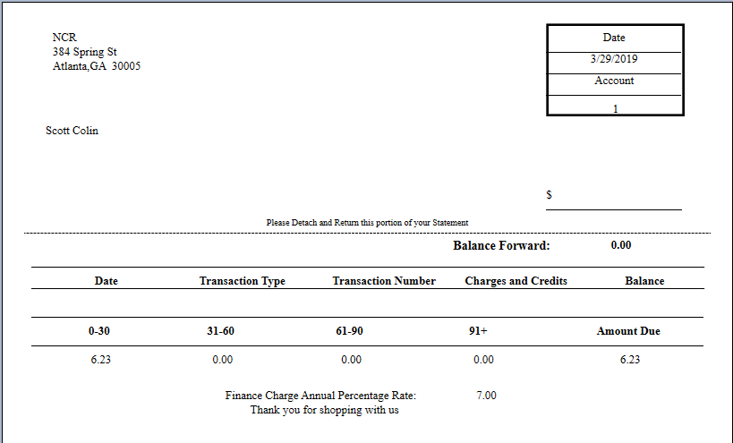
NCR Confidential
47
Notes:
Example of statement

Slide 48
THANK YOU
Return to Topics

Slide 49
ENCOR A/R Module (Detailed Version)

Slide 50
Customers
Search by Customer #, Last Name or Phone #
Customer Data
Charge
Customer #
Country
First Name
State
Zip Code
Last Name
Tax Exempt #
Phone 1
Aux Field
Phone 2
Comments
Address 1
External Reference #
Address 2
Employee
OFF
City
Charge
OFF
NCR Confidential
50

Slide 51
Customers
Search by Customer #, Last Name or Phone #
Customer Data
Charge
Customer #
Country
Search Customers
From Customer 41999900000 | To Customer 41999999999
First Name | Last Name
Zip Code | Phone Number
First Name
State
Zip Code
Last Name
Tax Exempt #
Phone 1
Aux Field
Phone 2
Comments
Address 1
External Reference #
Address 2
Employee
OFF
City
Charge
OFF
NCR Confidential
51

Slide 52
Customers
Hughes
41999900001 Toby Hughes 530-710-3668 4361 Clement Street Atlanta GA 55805
41999900012 Vivian Hughes 152-351-3253 2084 Junior Avenue Atlanta GA 55805
Customer Data
Charge
Customer #
Country
First Name
State
Zip Code
Last Name
Tax Exempt #
Phone 1
Aux Field
Phone 2
Comments
Address 1
External Reference #
Address 2
Employee
OFF
City
Charge
OFF
NCR Confidential
52

Slide 53
Customers
Search by Customer #, Last Name or Phone #
Customer Data
Charge
Customer Defaults
Country USA | Credit Limit $500.00
City Atlanta | Charge Status Good
State GA | APR 7.00%
Zip Code 54463 | Charge Employee
Aux Field Default Data | Finance Charge Compound Charges
Customer #
Country
First Name
State
Zip Code
Last Name
Tax Exempt #
Phone 1
Aux Field
Phone 2
Comments
Address 1
External Reference #
Address 2
Employee
OFF
City
Accounts Receivable
OFF
NCR Confidential
53

Slide 54
Customers
[Id between (41999900000 and 49999900000)]
41999900001 Toby Hughes 530-710-3668 4361 Clement Street Atlanta GA 55805
41999900002 Larry Simon 152-351-3253 2084 Junior Avenue Atlanta GA 55805
41999900003 Steven Austin 789-258-7894 1496 Jones Street Atlanta GA 55805
41999900004 Tomas Ward 439-896-1921 4616 Felosa Drive Atlanta GA 55805
41999900005 Arnold Brock 107-632-3651 952 Leverton Cove Road Atlanta GA 55805
41999900006 Samantha Moore 809-400-7045 1139 Steele Street Atlanta GA 55805
41999900007 Maryann Matthews 978-679-9404 3473 Sunset Drive Atlanta GA 55805
Customer Data
Charge
Customer #* 41999900001
Country USA
First Name Toby
State GA
Zip Code 55805
Last Name Hughes
Tax Exempt # 5466878
Phone 1 530-710-3668
Aux Field
Phone 2
Comments NSF $38.26 4/17/2017
Address 1 4361 Clement Street
External Reference #
Address 2
Employee
City Atlanta
Charge

Slide 55
Customers
[Id between (41999900000 and 49999900000)]
41999900001 Toby Hughes 530-710-3668 4361 Clement Street Atlanta GA 55805
41999900002 Larry Simon 152-351-3253 2084 Junior Avenue Atlanta GA 55805
41999900003 Steven Austin 789-258-7894 1496 Jones Street Atlanta GA 55805
41999900004 Tomas Ward 439-896-1921 4616 Felosa Drive Atlanta GA 55805
41999900005 Arnold Brock 107-632-3651 952 Leverton Cove Road Atlanta GA 55805
41999900006 Samantha Moore 809-400-7045 1139 Steele Street Atlanta GA 55805
41999900007 Maryann Matthews 978-679-9404 3473 Sunset Drive Atlanta GA 55805
Customer Data
Charge
Customer #* 41999900001
Country USA
First Name Toby
State GA
Zip Code 55805
Last Name Hughes
Tax Exempt # 5466878
Phone 1 530-710-3668
Aux Field
Phone 2
Comments NSF $38.26 4/17/2017
Address 1 4361 Clement Street
External Reference #
Address 2
Employee
City Atlanta
Charge
NCR Confidential
55

Slide 56
Customers
[Id between (41999900000 and 49999900000)]
41999900001 Toby Hughes 530-710-3668 4361 Clement Street Atlanta GA 55805
41999900002 Larry Simon 152-351-3253 2084 Junior Avenue Atlanta GA 55805
41999900003 Steven Austin 789-258-7894 1496 Jones Street Atlanta GA 55805
41999900004 Tomas Ward 439-896-1921 4616 Felosa Drive Atlanta GA 55805
41999900005 Arnold Brock 107-632-3651 952 Leverton Cove Road Atlanta GA 55805
41999900006 Samantha Moore 809-400-7045 1139 Steele Street Atlanta GA 55805
41999900007 Maryann Matthews 978-679-9404 3473 Sunset Drive Atlanta GA 55805
Customer Data
Charge
Date Opened 4/25/2009
APR %
Credit Limit 150.00
Finance Charge
Last Payment 2/15/2018
Compound Charges
Current Balance 79.86
Charge Status
NCR Confidential
56

Slide 57
Customers
Search by Customer #, Last Name or Phone #
Customer Data
Charge
Add Customer
Create Single Customer Account
Create Range of Customer Accounts
From Customer #
To Customer #
Country
Customer #
First Name
State
Zip Code
Last Name
Tax Exempt #
Phone 1
Aux Field
Phone 2
Comments
Address 1
External Reference #
Address 2
Employee
OFF
City
Charge
OFF
NCR Confidential
57

Slide 58
Customers
Search by Customer #, Last Name or Phone #
Customer Data
Charge
Customer #
Country
Add Customer
Create Single Customer Account
Create Range of Customer Accounts
From Customer #
To Customer #
First Name
State
Zip Code
Last Name
Tax Exempt #
Phone 1
Aux Field
Phone 2
Comments
Address 1
External Reference #
Address 2
Employee
OFF
City
Charge
OFF
NCR Confidential
58

Slide 59

Source Customer
Search by Customer #, Last Name or Phone #
Destination Customer
Search by Customer #, Last Name or Phone #
NCR Confidential
59

Slide 60
Source Customer
[Id between (41999900000 and 49999900000)]
41999900001 Toby Hughes 530-710-3668 4361 Clement Street Atlanta GA 55805
41999900002 Larry Simon 152-351-3253 2084 Junior Avenue Atlanta GA 55805
41999900003 Steven Austin 789-258-7894 1496 Jones Street Atlanta GA 55805
41999900004 Tomas Ward 439-896-1921 4616 Felosa Drive Atlanta GA 55805
41999900005 Arnold Brock 107-632-3651 952 Leverton Cove Road Atlanta GA 55805
41999900006 Samantha Moore 809-400-7045 1139 Steele Street Atlanta GA 55805
41999900007 Maryann Matthews 978-679-9404 3473 Sunset Drive Atlanta GA 55805
Destination Customer
Search by Customer #, Last Name or Phone #
NCR Confidential
60

Slide 61
Source Customer
Search by Customer #, Last Name or Phone #
Destination Customer
[Id between (41999900000 and 49999900000)]
41999900001 Toby Hughes 530-710-3668 4361 Clement Street Atlanta GA 55805
41999900002 Larry Simon 152-351-3253 2084 Junior Avenue Atlanta GA 55805
41999900003 Steven Austin 789-258-7894 1496 Jones Street Atlanta GA 55805
41999900004 Tomas Ward 439-896-1921 4616 Felosa Drive Atlanta GA 55805
41999900005 Arnold Brock 107-632-3651 952 Leverton Cove Road Atlanta GA 55805
41999900006 Samantha Moore 809-400-7045 1139 Steele Street Atlanta GA 55805
41999900007 Maryann Matthews 978-679-9404 3473 Sunset Drive Atlanta GA 55805
NCR Confidential
61

Slide 62
Source Customer
[Id between (41999900000 and 49999900000)]
41999900001 Toby Hughes 530-710-3668 4361 Clement Street Atlanta GA 55805
41999900002 Larry Simon 152-351-3253 2084 Junior Avenue Atlanta GA 55805
41999900003 Steven Austin 789-258-7894 1496 Jones Street Atlanta GA 55805
41999900004 Tomas Ward 439-896-1921 4616 Felosa Drive Atlanta GA 55805
41999900005 Arnold Brock 107-632-3651 952 Leverton Cove Road Atlanta GA 55805
41999900006 Samantha Moore 809-400-7045 1139 Steele Street Atlanta GA 55805
Destination Customer
[Id between (41999900000 and 49999900000)]
41999900001 Toby Hughes 530-710-3668 4361 Clement Street Atlanta GA 55805
41999900002 Larry Simon 152-351-3253 2084 Junior Avenue Atlanta GA 55805
41999900003 Steven Austin 789-258-7894 1496 Jones Street Atlanta GA 55805
41999900004 Tomas Ward 439-896-1921 4616 Felosa Drive Atlanta GA 55805
41999900005 Arnold Brock 107-632-3651 952 Leverton Cove Road Atlanta GA 55805
41999900006 Samantha Moore 809-400-7045 1139 Steele Street Atlanta GA 55805
NCR Confidential
62

Slide 63
Fields | Source Customer | Destination Customer | Preview
Customer Number | 41999900001 | 41999900002 | 41999900002
First Name | Toby | Larry | Toby
Last Name | Hughes | Simon | Hughes
Address 1 | 4361 Clement Street | 2084 Junior Avenue | 4361 Clement Street
Address 2
City | Atlanta | Atlanta | Atlanta
State | GA | GA | GA
Zip Code | 55805 | 55805 | 55805
Phone 1 | 5307103668 | 1523513253 | 5307103668
Phone 2
Tax Exempt # | 123456789 | 987654321 | 123456789
Aux Field |  | Test Data
Comments | NSF $38.26 4/17/2017 |  | NSF $38.26 4/17/2017
External Reference # | AB786786 |  | AB786786
Date Opened | 11/17/2008 | 4/30/2018 | 11/17/2008
Credit Limit | $500.00 | $100.00 | $500.00
Last Payment | 2/27/2018 |  | 2/27/2018
Current Balance | $27.68 | $10.00 | $37.68
NCR Confidential
63

Slide 64
Fields | Source Customer | Destination Customer | Preview
State | GA | GA | GA
Zip Code | 55805 | 55805 | 55805
Phone 1 | 5307103668 | 1523513253 | 5307103668
Phone 2
Tax Exempt # | 123456789 | 987654321 | 123456789
Aux Field |  | Test Data
Comments | NSF $38.26 4/17/2017 |  | NSF $38.26 4/17/2017
External Reference # | AB786786 |  | AB786786
Date Opened | 11/17/2008 | 4/30/2018 | 11/17/2008
Credit Limit | $500.00 | $100.00 | $500.00
Last Payment | 2/27/2018 |  | 2/27/2018
Current Balance | $27.68 | $10.00 | $37.68
Charge Status | Good | Good | Good
APR % | 2.0% | 3.5% | 2.0%
Employee
Accounts Receivable
Finance Charge
Compound Charges
NCR Confidential
64

Slide 65
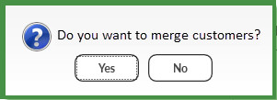
Fields | Source Customer | Destination Customer | Preview
State | GA | GA | GA
Zip Code | 55805 | 55805 | 55805
Phone 1 | 5307103668 | 1523513253 | 5307103668
Phone 2
Tax Exempt # | 123456789 | 987654321 | 123456789
Aux Field |  | Test Data
Comments | NSF $38.26 4/17/2017 |  | NSF $38.26 4/17/2017
External Reference # | AB786786 |  | AB786786
Date Opened | 11/17/2008 | 4/30/2018 | 11/17/2008
Credit Limit | $500.00 | $100.00 | $500.00
Last Payment | 2/27/2018 |  | 2/27/2018
Current Balance | $27.68 | $10.00 | $37.68
Charge Status | Good | Good | Good
APR % | 2.0% | 3.5% | 2.0%
Employee
Accounts Receivable
Finance Charge
Compound Charges
NCR Confidential
65

Slide 66
Source Customer
[Id between (41999900000 and 49999900000)]
41999900002 Toby Hughes 530-710-3668 4361 Clement Street Atlanta GA 55805
41999900003 Steven Austin 789-258-7894 1496 Jones Street Atlanta GA 55805
41999900004 Tomas Ward 439-896-1921 4616 Felosa Drive Atlanta GA 55805
41999900005 Arnold Brock 107-632-3651 952 Leverton Cove Road Atlanta GA 55805
41999900006 Samantha Moore 809-400-7045 1139 Steele Street Atlanta GA 55805
Destination Customer
[Id between (41999900000 and 49999900000)]
41999900002 Toby Hughes 530-710-3668 4361 Clement Street Atlanta GA 55805
41999900003 Steven Austin 789-258-7894 1496 Jones Street Atlanta GA 55805
41999900004 Tomas Ward 439-896-1921 4616 Felosa Drive Atlanta GA 55805
41999900005 Arnold Brock 107-632-3651 952 Leverton Cove Road Atlanta GA 55805
41999900006 Samantha Moore 809-400-7045 1139 Steele Street Atlanta GA 55805
NCR Confidential
66

Slide 67

Customers
Search by Customer #, Last Name or Phone #
General
Totals
All
Date Opened
All
Purchase to Date ($)
All
Date of Last Visit
All
Purchases this Period ($)
All
Visits to Date
All
Manual Overrides
All
Visits this Period
Report Options
Sort By Customer Number
Top/Bottom | Number of Records
Summary Report Only
NCR Confidential
67

Slide 68

Customers
[Id between (41999900000 and 49999900000)]
41999900001 Toby Hughes 530-710-3668 4361 Clement Street Atlanta GA 55805
41999900002 Larry Simon 152-351-3253 2084 Junior Avenue Atlanta GA 55805
41999900003 Steven Austin 789-258-7894 1496 Jones Street Atlanta GA 55805
41999900004 Tomas Ward 439-896-1921 4616 Felosa Drive Atlanta GA 55805
41999900005 Arnold Brock 107-632-3651 952 Leverton Cove Road Atlanta GA 55805
41999900006 Samantha Moore 809-400-7045 1139 Steele Street Atlanta GA 55805
41999900007 Maryann Matthews 978-679-9404 3473 Sunset Drive Atlanta GA 55805
General
Totals
Date Opened 4/17/2018
=
All
Purchase to Date ($)
All
Date of Last Visit
All
Purchases this Period ($)
All
Visits to Date
All
Manual Overrides
Visits this Period 5
>
Report Options
Sort By Customer Number
Top/Bottom | Number of Records
Summary Report Only

Slide 69
Customers
[Id between (41999900000 and 49999900000)]
41999900001 Toby Hughes 530-710-3668 4361 Clement Street Atlanta GA 55805
41999900002 Larry Simon 152-351-3253 2084 Junior Avenue Atlanta GA 55805
41999900003 Steven Austin 789-258-7894 1496 Jones Street Atlanta GA 55805
41999900004 Tomas Ward 439-896-1921 4616 Felosa Drive Atlanta GA 55805
41999900005 Arnold Brock 107-632-3651 952 Leverton Cove Road Atlanta GA 55805
41999900006 Samantha Moore 809-400-7045 1139 Steele Street Atlanta GA 55805
41999900007 Maryann Matthews 978-679-9404 3473 Sunset Drive Atlanta GA 55805
General
Totals
Points to Date 50
=
All
Purchase to Date ($)
All
Points this Period
All
Purchases this Period ($)
All
Promo Points to Date
All
Manual Overrides
Report Options
Sort By Customer Number
Top/Bottom | Number of Records
Summary Report Only
NCR Confidential
69

Slide 70
Print
Preview
Customer Range
From Customer
To Customer
Report Selection
Aging Report | Activity Report
Aging Date
Current
Report Type
Regular | Summary | Aging Total
Sort By
Account # | Last Name
Suppress Zero Balance Accounts
NCR Confidential
70

Slide 71
Print
Preview
Customer Range
From Customer 41000000001
To Customer 41999999999
Report Selection
Aging Report | Activity Report
Aging Date
Current
Report Type
Regular | Summary | Aging Total
Sort By
Account # | Last Name
Suppress Zero Balance Accounts
NCR Confidential
71

Slide 72


Print
Preview
Customer Range
From Customer 41000000001
To Customer 41999999999
Report Selection
Aging Report | Activity Report
Date Range
Report Type
Regular | Summary | Payment Flash
NCR Confidential
72

Slide 73
Save
Customers
Search by Customer #, Last Name or Phone #
Type
Account Information
Adjustment | Payment
Balance Due
Amount
Credit Limit
Memo
Charge Status
Aging Status
0 – 30 Days
31 – 60 Days
CALCULATE FINANCE CHARGE
61 – 90 Days
FINANCE CHARGE ADJUSTMENT
91+ Days
NCR Confidential
73

Slide 74
Save
Customers
Search by Customer #, Last Name or Phone #
Type
Account Information
Adjustment | Payment
Balance Due
Search Customers
From Customer 41999900000 | To Customer 41999999999
First Name | Last Name
Zip Code | Phone Number
Amount
Credit Limit
Memo
Charge Status
Aging Status
0 – 30 Days
31 – 60 Days
CALCULATE FINANCE CHARGE
61 – 90 Days
FINANCE CHARGE ADJUSTMENT
91+ Days
NCR Confidential
74

Slide 75
Save
Customers
[Advanced Search]
41999900001 Toby Hughes 530-710-3668 4361 Clement Street Atlanta GA 55805
41999900002 Larry Simon 152-351-3253 2084 Junior Avenue Atlanta GA 55805
41999900003 Steven Austin 789-258-7894 1496 Jones Street Atlanta GA 55805
41999900004 Tomas Ward 439-896-1921 4616 Felosa Drive Atlanta GA 55805
41999900005 Arnold Brock 107-632-3651 952 Leverton Cove Road Atlanta GA 55805
41999900006 Samantha Moore 809-400-7045 1139 Steele Street Atlanta GA 55805
41999900007 Maryann Matthews 978-679-9404 3473 Sunset Drive Atlanta GA 55805
Type
Account Information
Adjustment | Payment
Balance Due
Amount
Credit Limit
Memo
Charge Status
Aging Status
0 – 30 Days
31 – 60 Days
CALCULATE FINANCE CHARGE
61 – 90 Days
FINANCE CHARGE ADJUSTMENT
91+ Days
NCR Confidential
75

Slide 76
Save
Customers
Hughes
41999900001 Toby Hughes 530-710-3668 4361 Clement Street Atlanta GA 55805
41999900012 Vivian Hughes 152-351-3253 2084 Junior Avenue Atlanta GA 55805
Type
Account Information
Adjustment | Payment
Balance Due
Amount
Credit Limit
Memo
Charge Status
Aging Status
0 – 30 Days
31 – 60 Days
CALCULATE FINANCE CHARGE
61 – 90 Days
FINANCE CHARGE ADJUSTMENT
91+ Days
NCR Confidential
76

Slide 77
Save
Customers
Hughes
41999900001 Toby Hughes 530-710-3668 4361 Clement Street Atlanta GA 55805
41999900012 Vivian Hughes 152-351-3253 2084 Junior Avenue Atlanta GA 55805
Type
Account Information
Balance Due $-4.00
Adjustment | Payment
Amount
Credit Limit $1000.00
Charge Status Good
Memo
Aging Status
0 – 30 Days -4.00
31 – 60 Days 0.00
61 – 90 Days 0.00
CALCULATE FINANCE CHARGE
91+ Days 0.00
FINANCE CHARGE ADJUSTMENT
NCR Confidential
77

Slide 78
Save
Customers
Hughes
41999900001 Toby Hughes 530-710-3668 4361 Clement Street Atlanta GA 55805
41999900012 Vivian Hughes 152-351-3253 2084 Junior Avenue Atlanta GA 55805
Type
Account Information
Balance Due $-4.00
Adjustment | Payment
Amount $4.00
Credit Limit $1000.00
Memo Incorrect payment amount entered
Charge Status Good
Aging Status
0 – 30 Days -4.00
31 – 60 Days 0.00
61 – 90 Days 0.00
CALCULATE FINANCE CHARGE
91+ Days 0.00
FINANCE CHARGE ADJUSTMENT
NCR Confidential
78

Slide 79
Save
Customers
Hughes
41999900001 Toby Hughes 530-710-3668 4361 Clement Street Atlanta GA 55805
41999900012 Vivian Hughes 152-351-3253 2084 Junior Avenue Atlanta GA 55805
Type
Account Information
Balance Due $0.00
Adjustment | Payment
Amount
Credit Limit $1000.00
Memo
Charge Status Good
Aging Status
0 – 30 Days 0.00
31 – 60 Days 0.00
61 – 90 Days 0.00
CALCULATE FINANCE CHARGE
91+ Days 0.00
FINANCE CHARGE ADJUSTMENT
NCR Confidential
79

Slide 80
Save
Customers
Hughes
41999900001 Toby Hughes 530-710-3668 4361 Clement Street Atlanta GA 55805
41999900012 Vivian Hughes 152-351-3253 2084 Junior Avenue Atlanta GA 55805
Type
Account Information
Balance Due $152.68
Adjustment | Payment
Amount $152.68
Credit Limit $1000.00
Tender Cash
Charge Status Good
Aging Status
0 – 30 Days 152.68
31 – 60 Days 0.00
61 – 90 Days 0.00
CALCULATE FINANCE CHARGE
91+ Days 0.00
FINANCE CHARGE ADJUSTMENT
NCR Confidential
80

Slide 81
Save
Customers
Hughes
41999900001 Toby Hughes 530-710-3668 4361 Clement Street Atlanta GA 55805
41999900012 Vivian Hughes 152-351-3253 2084 Junior Avenue Atlanta GA 55805
Type
Account Information
Balance Due $0.00
Adjustment | Payment
Amount
Credit Limit $1000.00
Tender
Charge Status Good
Aging Status
0 – 30 Days 0.00
31 – 60 Days 0.00
61 – 90 Days 0.00
CALCULATE FINANCE CHARGE
91+ Days 0.00
FINANCE CHARGE ADJUSTMENT
NCR Confidential
81

Slide 82
Save
Customers
Search by Customer #, Last Name or Phone #
Type
Account Information
Adjustment | Payment
Balance Due
Amount
Credit Limit
Memo
Charge Status
Aging Status
0 – 30 Days
31 – 60 Days
CALCULATE FINANCE CHARGE
61 – 90 Days
FINANCE CHARGE ADJUSTMENT
91+ Days
NCR Confidential
82

Slide 83
Save
Customers
Search by Customer #, Last Name or Phone #
Type
Account Information
Adjustment | Payment
Balance Due
Search Customers
From Customer 41999900000 | To Customer 41999999999
First Name | Last Name
Zip Code | Phone Number
Amount
Credit Limit
Memo
Charge Status
Aging Status
0 – 30 Days
31 – 60 Days
CALCULATE FINANCE CHARGE
61 – 90 Days
FINANCE CHARGE ADJUSTMENT
91+ Days
NCR Confidential
83

Slide 84
Save
Customers
[Advanced Search]
41999900001 Toby Hughes 530-710-3668 4361 Clement Street Atlanta GA 55805
41999900002 Larry Simon 152-351-3253 2084 Junior Avenue Atlanta GA 55805
41999900003 Steven Austin 789-258-7894 1496 Jones Street Atlanta GA 55805
41999900004 Tomas Ward 439-896-1921 4616 Felosa Drive Atlanta GA 55805
41999900005 Arnold Brock 107-632-3651 952 Leverton Cove Road Atlanta GA 55805
41999900006 Samantha Moore 809-400-7045 1139 Steele Street Atlanta GA 55805
41999900007 Maryann Matthews 978-679-9404 3473 Sunset Drive Atlanta GA 55805
Type
Account Information
Adjustment | Payment
Balance Due
Amount
Credit Limit
Memo
Charge Status
Aging Status
0 – 30 Days
31 – 60 Days
CALCULATE FINANCE CHARGE
61 – 90 Days
FINANCE CHARGE ADJUSTMENT
91+ Days
NCR Confidential
84

Slide 85
Save
Customers
Hughes
41999900001 Toby Hughes 530-710-3668 4361 Clement Street Atlanta GA 55805
41999900012 Vivian Hughes 152-351-3253 2084 Junior Avenue Atlanta GA 55805
Type
Account Information
Adjustment | Payment
Balance Due
Amount
Credit Limit
Memo
Charge Status
Aging Status
0 – 30 Days
31 – 60 Days
CALCULATE FINANCE CHARGE
61 – 90 Days
FINANCE CHARGE ADJUSTMENT
91+ Days
NCR Confidential
85

Slide 86
Save
Customers
Hughes
41999900001 Toby Hughes 530-710-3668 4361 Clement Street Atlanta GA 55805
41999900012 Vivian Hughes 152-351-3253 2084 Junior Avenue Atlanta GA 55805
Type
Account Information
Balance Due $-4.00
Adjustment | Payment
Amount
Credit Limit $1000.00
Charge Status Good
Memo
Aging Status
0 – 30 Days -4.00
31 – 60 Days 0.00
61 – 90 Days 0.00
CALCULATE FINANCE CHARGE
91+ Days 0.00
FINANCE CHARGE ADJUSTMENT
NCR Confidential
86

Slide 87
Save
Customers
Hughes
41999900001 Toby Hughes 530-710-3668 4361 Clement Street Atlanta GA 55805
41999900012 Vivian Hughes 152-351-3253 2084 Junior Avenue Atlanta GA 55805
Type
Account Information
Balance Due $-4.00
Adjustment | Payment
Amount $4.00
Credit Limit $1000.00
Memo Incorrect payment amount entered
Charge Status Good
Aging Status
0 – 30 Days -4.00
31 – 60 Days 0.00
61 – 90 Days 0.00
CALCULATE FINANCE CHARGE
91+ Days 0.00
FINANCE CHARGE ADJUSTMENT
NCR Confidential
87

Slide 88
Save
Customers
Hughes
41999900001 Toby Hughes 530-710-3668 4361 Clement Street Atlanta GA 55805
41999900012 Vivian Hughes 152-351-3253 2084 Junior Avenue Atlanta GA 55805
Type
Account Information
Balance Due $0.00
Adjustment | Payment
Amount
Credit Limit $1000.00
Memo
Charge Status Good
Aging Status
0 – 30 Days 0.00
31 – 60 Days 0.00
61 – 90 Days 0.00
CALCULATE FINANCE CHARGE
91+ Days 0.00
FINANCE CHARGE ADJUSTMENT
NCR Confidential
88

Slide 89
Save
Customers
Hughes
41999900001 Toby Hughes 530-710-3668 4361 Clement Street Atlanta GA 55805
41999900012 Vivian Hughes 152-351-3253 2084 Junior Avenue Atlanta GA 55805
Type
Account Information
Balance Due $152.68
Adjustment | Payment
Amount $152.68
Credit Limit $1000.00
Tender Cash
Charge Status Good
Aging Status
0 – 30 Days 152.68
31 – 60 Days 0.00
61 – 90 Days 0.00
CALCULATE FINANCE CHARGE
91+ Days 0.00
FINANCE CHARGE ADJUSTMENT
NCR Confidential
89

Slide 90
Save
Customers
Hughes
41999900001 Toby Hughes 530-710-3668 4361 Clement Street Atlanta GA 55805
41999900012 Vivian Hughes 152-351-3253 2084 Junior Avenue Atlanta GA 55805
Type
Account Information
Balance Due $0.00
Adjustment | Payment
Amount
Credit Limit $1000.00
Tender
Charge Status Good
Aging Status
0 – 30 Days 0.00
31 – 60 Days 0.00
61 – 90 Days 0.00
CALCULATE FINANCE CHARGE
91+ Days 0.00
FINANCE CHARGE ADJUSTMENT
NCR Confidential
90

Slide 91
THANK YOU
Return to Topics

Slide 92
NCR Platform: Digital Receipts

Slide 93


NCR Digital Receipts
Problem: Shoppers want less paper in their wallets, bags and around the house
Solution: Offer them a digital receipt via email, text, or the Web
Grocer Benefits
Do more with your receipts
Digital coupons
Advertisements
Increase shopper loyalty
Incremental revenue and margin
Consolidate suppliers
Green initiative
Shopper Benefits
Enhanced experience – receipt choice
Easily organize receipts
Dynamic offers and rewards
Easy access to product information, including returns or recalls
Green initiative
NCR Confidential
93
Notes:
NCR is a global technology company with one thing in mind: make everyday easier for the consumer. To do this, we are combining our 128 years of experience in the consumables business with our software to provide both a paper receipt and a digital receipt. This solution, known as NCR eReceipt, is what I would like to talk to you about today.
NCR is proud to now offer you the choice of digital receipt or paper receipt. Digital receipts aren't meant to replace their paper counterparts, and we do not think they will take over all of the receipt business, but they do ease customer transactions and provide added value. We offer a solution that will be greener, and increase brand loyalty at the same time. Another key point is that you will now be able to get all of your receipt solution needs from one supplier.
As you can see from the slide, both the retailer and customer greatly benefit from the eReceipt solution. Retailers have access to more touch points with the customer, which can help them drive additional revenue and increase customer loyalty. They can consolidate their suppliers and incorporate a green initiative. Customers are able to have the choice of paper or digital at the Point of Sale, easily organize their receipts and have access to a secure way of managing their transaction data.
While percentages of digital receipts vs paper receipts will vary by customer and region, this is a chance to offer a complete solution to the market, which does not exist today.

Slide 94
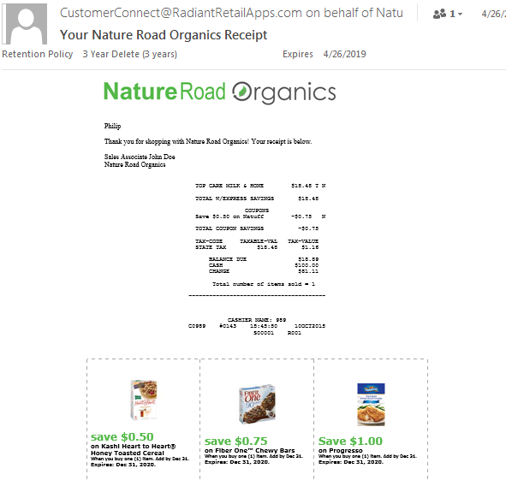
Digital Receipts Feature Overview
Email receipts
SMS receipts
Digital Receipt Portal
SaaS deployment
Offer targeted coupons
Part of NCR Platform
NCR Confidential
94
Notes:
NCR is a global technology company with one thing in mind: make everyday easier for the consumer. To do this, we are combining our 128 years of experience in the consumables business with our software to provide both a paper receipt and a digital receipt. This solution, known as NCR eReceipt, is what I would like to talk to you about today.
NCR is proud to now offer you the choice of digital receipt or paper receipt. Digital receipts aren't meant to replace their paper counterparts, and we do not think they will take over all of the receipt business, but they do ease customer transactions and provide added value. We offer a solution that will be greener, and increase brand loyalty at the same time. Another key point is that you will now be able to get all of your receipt solution needs from one supplier.
As you can see from the slide, both the retailer and customer greatly benefit from the eReceipt solution. Retailers have access to more touch points with the customer, which can help them drive additional revenue and increase customer loyalty. They can consolidate their suppliers and incorporate a green initiative. Customers are able to have the choice of paper or digital at the Point of Sale, easily organize their receipts and have access to a secure way of managing their transaction data.
While percentages of digital receipts vs paper receipts will vary by customer and region, this is a chance to offer a complete solution to the market, which does not exist today.

Slide 95
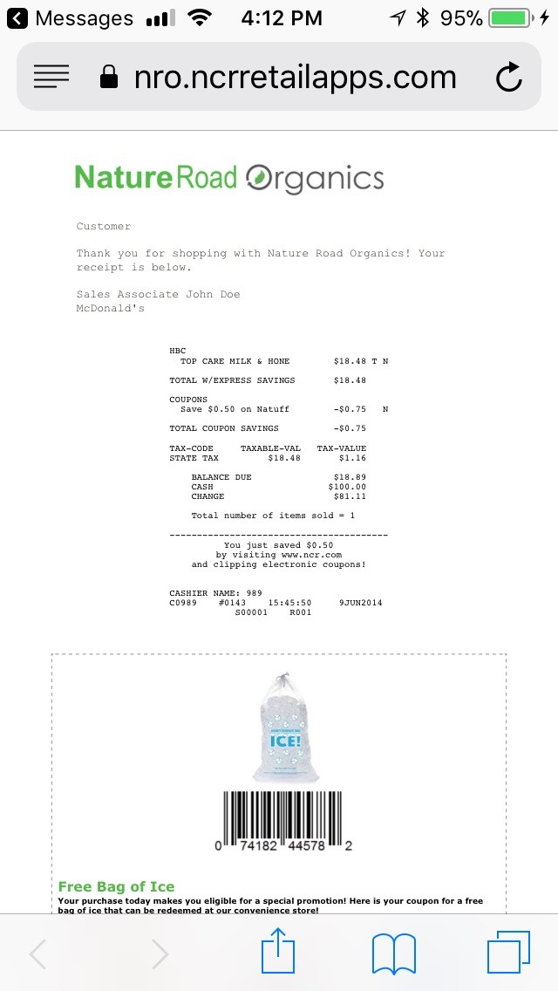
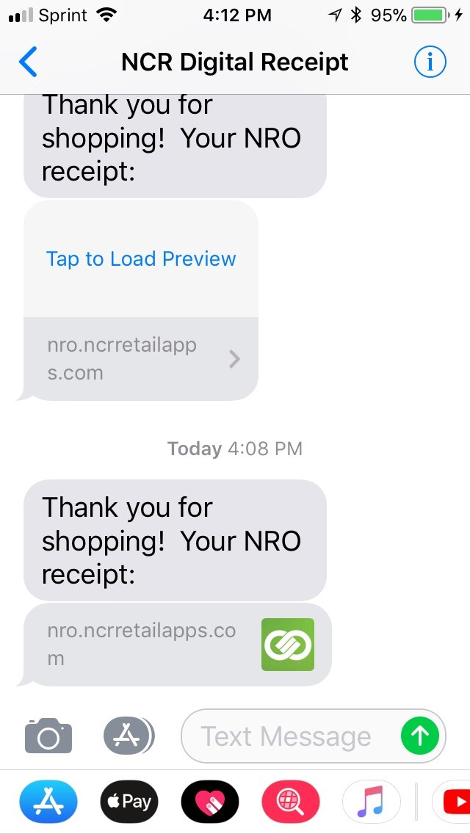
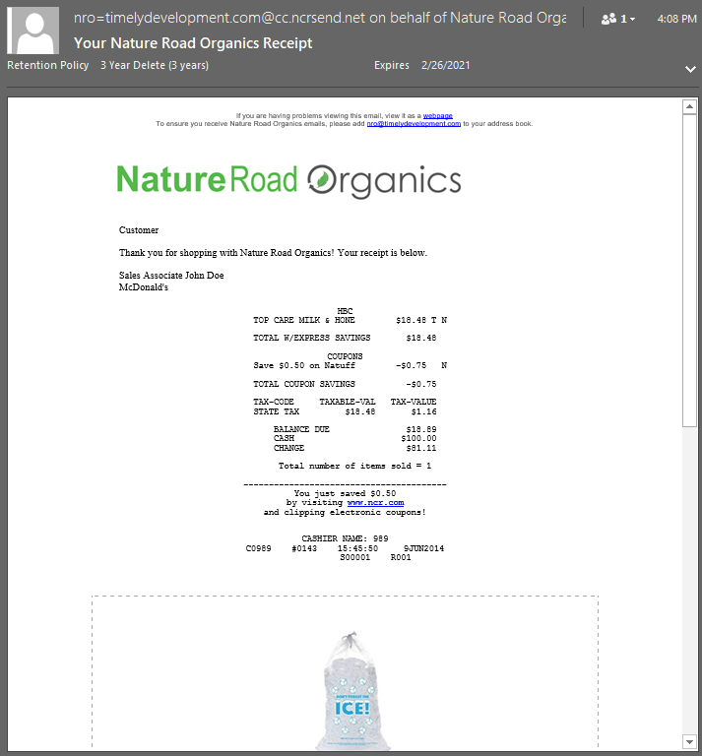
Email and SMS
NCR Confidential
95
Notes:
NCR is a global technology company with one thing in mind: make everyday easier for the consumer. To do this, we are combining our 128 years of experience in the consumables business with our software to provide both a paper receipt and a digital receipt. This solution, known as NCR eReceipt, is what I would like to talk to you about today.
NCR is proud to now offer you the choice of digital receipt or paper receipt. Digital receipts aren't meant to replace their paper counterparts, and we do not think they will take over all of the receipt business, but they do ease customer transactions and provide added value. We offer a solution that will be greener, and increase brand loyalty at the same time. Another key point is that you will now be able to get all of your receipt solution needs from one supplier.
As you can see from the slide, both the retailer and customer greatly benefit from the eReceipt solution. Retailers have access to more touch points with the customer, which can help them drive additional revenue and increase customer loyalty. They can consolidate their suppliers and incorporate a green initiative. Customers are able to have the choice of paper or digital at the Point of Sale, easily organize their receipts and have access to a secure way of managing their transaction data.
While percentages of digital receipts vs paper receipts will vary by customer and region, this is a chance to offer a complete solution to the market, which does not exist today.

Slide 96

Digital Receipts with Coupons
These digital coupons can be clipped to loyalty system and redeemed at check out, targeted to each customer
NCR Confidential
96
Notes:
NCR is a global technology company with one thing in mind: make everyday easier for the consumer. To do this, we are combining our 128 years of experience in the consumables business with our software to provide both a paper receipt and a digital receipt. This solution, known as NCR eReceipt, is what I would like to talk to you about today.
NCR is proud to now offer you the choice of digital receipt or paper receipt. Digital receipts aren't meant to replace their paper counterparts, and we do not think they will take over all of the receipt business, but they do ease customer transactions and provide added value. We offer a solution that will be greener, and increase brand loyalty at the same time. Another key point is that you will now be able to get all of your receipt solution needs from one supplier.
As you can see from the slide, both the retailer and customer greatly benefit from the eReceipt solution. Retailers have access to more touch points with the customer, which can help them drive additional revenue and increase customer loyalty. They can consolidate their suppliers and incorporate a green initiative. Customers are able to have the choice of paper or digital at the Point of Sale, easily organize their receipts and have access to a secure way of managing their transaction data.
While percentages of digital receipts vs paper receipts will vary by customer and region, this is a chance to offer a complete solution to the market, which does not exist today.

Slide 97
THANK YOU
Return to Topics

Slide 98
Digital Coupons over NCR Platform with Inmar

Slide 99
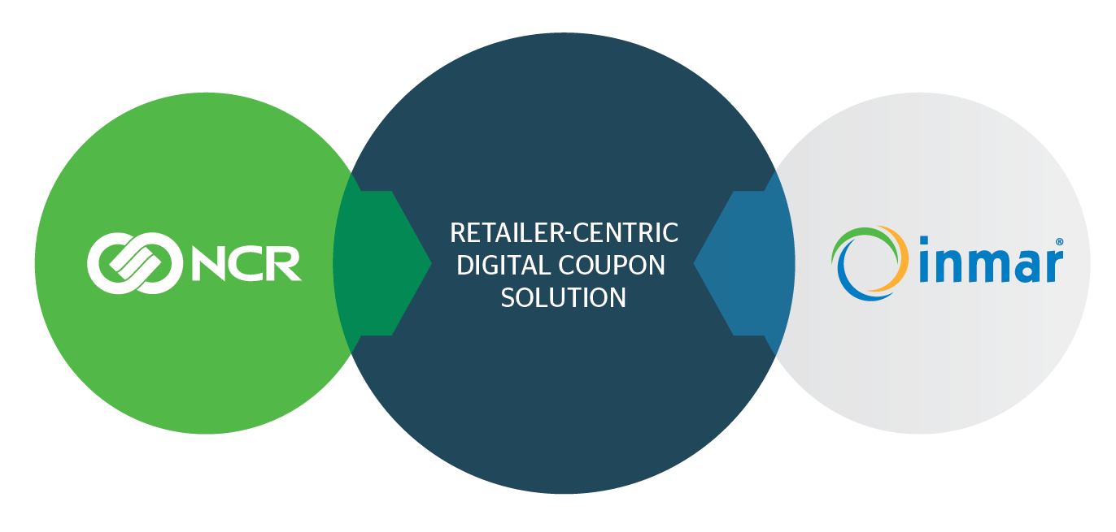
NCR and Inmar Joint Offering
A comprehensive, end-to-end digital coupon solution
Leader in POS and Marketing Solutions
Leader in Digital Coupons
NCR Confidential
99
Notes:
NCR and Inmar have joined together to create a comprehensive digital coupon solution
This strategic partnership will enable NCR customers to easily and quickly introduce digital coupons to their customers, and achieve increased strategic control over their promotion programming:
The program is built for the retailer and promotes the retailer brand (Inmar and NCR are “white label”)
Putting the retailer in the “driver‘s seat” of the Digital Economy
Easily places digital coupons in existing retailer loyalty ecosystems
Instantly integrates offers from multiple third parties

Slide 100



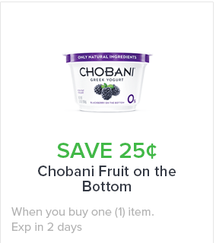
Value Proposition
Inmar's content, delivered in real-time, complements NCR's Customer & Marketing solutions
Reduce integration efforts, and enable retailers to save significant time and money
Keep pace with the new digital economy:
Easily offer digital coupons via your loyalty program
NCR Confidential
100
Notes:
Integrating Inmar’s cloud-based solution with its own portfolio of offerings, NCR will help retailers capitalize on the growing, consumer-driven “paper-to-digital coupon” shift, while leveraging their existing investment in loyalty and point-of-sale systems.
Creating a true end-to-end solution

Slide 101













End-to-End Solution
Publishing and distribution
Offer reaches retailer
Digital offer displayed via any retailer-owned digital channel
Manufacturer issues coupon
Shopper loads offer to account
Retailer handling
Upon checkout, offer automatically redeemed
In the store, shopper adds item to basket
Offer removed from shopper card via the cloud
Clearing and settlement
Electronic redemption
Analytics validating effectiveness and improvement
Settlement process
NCR Confidential
101
Notes:
Our combined solution captures the entire digital coupon value chain – from the manufacturer, through retail operation systems, marketing systems, clipping, redemption and clearing, and all the way to analytics

Slide 102
THANK YOU
Return to Topics

Slide 103
FastLane Mobile Shopper

Slide 104


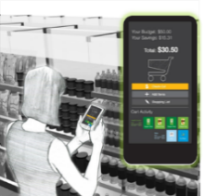



Introducing FastLane Mobile Shopper
A comprehensive self-scanning solution that enables consumers to scan-as-they-shop to:
Reduce
wait times
View product information
or location information
Track and
control spending
Self-service
for large baskets
In-store location based targeted promotions
NCR Confidential
104
Notes:
A comprehensive self-scanning solution that enables consumers to scan-as-the-shop to:
Have a self-service option for large baskets
Reduce wait times
Track and control spending
View product information or location information
Receive targeted promotions based on location in the store

Slide 105





How does FastLane Mobile Shopper work?
Shoppers connect with their loyalty programs at home or in-store to access offers, promotions and shopping lists
When ready to finalize, go to the FastLane, scan the on-screen barcode to begin checkout. Add any other items, pay by cash, card or mobile. Go.
Shop and scan items, apply coupons/offers, access shopping lists, or even get product info and navigation
For age-restricted items or for a randomized security check, the attendant is ready to assist to expedite checkout
NCR Confidential
105

Slide 106

Software Highlights
Software Features
Offers location-based promotions, in-store navigation, and shopping list integration
Integrates with NCR FastLane self-checkout and loyalty applications
Mobile payment support
Configurable trust levels and auditing capability
Customization and multilingual support
Includes offline capability
Leverages FastLane remote attendant program for transaction exceptions, age-restricted items, and security rescans
Supports iOS and Android platforms and enterprise, store and cloud server architecture
NCR Confidential
106

Slide 107
THANK YOU
Return to Topics

Slide 108
ENCOR Migration Tools

Slide 109
Database Migration Tool
ScanMaster
Select All
Clear All
Item/PLU Maintenance
Customer
Department
AR Accounts
Sub Department
Enhanced Bad Accounts
Bottle Links
Go Back
Continue
CANCEL
NCR Confidential
109

Slide 110
Database Migration Tool
Customer Configuration Options
POS Points to Include in Points:
POS Secondary ID to use:
Points to Date
Phone Number
Bonus Points to Date
Driver’s License
Special Points
User Define
POS Savings to Include in Savings:
Frequent Shopper Discount to Date
Electronic Promotion to Date
Go Back
Continue
CANCEL
NCR Confidential
110

Slide 111




Database Migration Tool
Errors Occurred Check F:\DBMigration.Log
02-02-2018 17:20:45 GR2Item.btr begin conversion
02-02-2018 17:26:55 30,588 records converted
02-02-2018 17:27:15 GR2Item.btr end conversion
02-02-2018 17:28:12 BXxxxxxx.dat created in F:\DB Conversion
02-02-2018 17:28:25 GR2Dept.btr begin conversion
02-02-2018 17:33:25 [LNA][Pervasive][ODBC Engine Interface][Data Record Manager]The MicroKernel cannot find the specified file(Btrieve Error 12)
02-02-2018 17:33:37 GR2SUBD.btr begin conversion
02-02-2018 17:37:04 34 records converted
02-02-2018 17:37:49 GR2SUBD.btr end conversion
02-02-2018 17:38:40 BX037xxxxxx.dat created in F:\DB Conversion
02-02-2018 17:40:22 Tare Weights Table converted
02-02-2018 17:40:37 Botlink.dat conversion begin
02-02-2018 17:40:44 149 records created
02-02-2018 17:41:15 BX156xxxxxx.dat created in F:\DB Conversion
02-02-2018 17:41:15 BX157xxxxxx.dat created in F:\DB Conversion
02-02-2018 17:42:02 Botlink.dat conversion end
02-02-2018 17:44:16 GR2CUST.btr begin conversion
02-02-2018 17:45:18 Getting Data from GR2CUSTX.btr
02-02-2018 17:55:49 10,255 records converted
02-02-2018 17:57:33 GR2CUST.btr end conversion
02-02-2018 17:59:45 BX001xxxxxx.dat created in F:\DB Conversion
02-02-2018 18:01:24 GR2NCHEK.btr begin conversion
02-02-2018 18:03:15 385 records converted
02-02-2018 18:03:55 GR2HCHEK.btr end conversion
02-02-2018 18:04:05 BX150xxxxxx.dat created in F:\DB Conversion
Converted Files exist in F:\DB Migration
Item/PLU Maintenance
Customer
Department
Enhanced Bad Accounts
Sub Department
Bottle Links
DB Files
LOG
CANCEL
NCR Confidential
111

Slide 112

Database Migration Tool
02-02-2018 17:20:45 GR2Item.btr begin conversion
02-02-2018 17:26:55 30,588 records converted
02-02-2018 17:27:15 GR2Item.btr end conversion
02-02-2018 17:28:12 BXxxxxxx.dat created in F:\DB Conversion
02-02-2018 17:28:25 GR2Dept.btr begin conversion
02-02-2018 17:33:25 [LNA][Pervasive][ODBC Engine Interface][Data Record Manager]The MicroKernel cannot find the specified file(Btrieve Error 12)
02-02-2018 17:33:37 GR2SUBD.btr begin conversion
02-02-2018 17:37:04 34 records converted
02-02-2018 17:37:49 GR2SUBD.btr end conversion
02-02-2018 17:38:40 BX037xxxxxx.dat created in F:\DB Conversion
Item/PLU Maintenance
Customer
Department
Enhanced Bad Accounts
Sub Department
Tare Weights
Bottle Links
START
CANCEL
NCR Confidential
112

Slide 113
THANK YOU
Return to Topics

