Slide 1
ENCOR
Retail Solution Overview
[Your Name]
[Your Date]

Slide 2



Slide 3

ENCOR — by Popular Demand
Proven DNA based on a product with…
Created from the DNA of NCR’s proven POS solutions
12,000*
60,000
100s
of Millions
Stores installed with
NCR DNA
Touchpoints installed
with
NCR DNA
Transactions daily, powered by
NCR Innovation
*North America independent
and regional chain stores

Slide 4

Why ENCOR: Cutting Risks from Your Operation
Operations Risks
  Proven features, flexibility, connectability
  Reliability, stability
Business Risks
  Operational costs, how you run a business
  Keeping your customers
  Keeping up with the future
Partnership Risks
  Who will stand with you
  Whom can you trust
  Who proves their history every day
4
NCR Confidential

Slide 5








Solving the Risks for Running your Stores
Problem
Operations Risks
NCR’s Response
How do I know the system will work the way I want?
ENCOR sums up 75 combined years of flexibility, depth and enhancements, the best of ISS45, ACS-IR and ScanMaster
How do I know the system will support my technical and application environment?
ENCOR has unmatched connections to third-party apps as well as NCR’s —everything from your current setup
How can I be sure the system will be reliable?
ENCOR is tested and CERTIFIED to run with the hardware, applications, payment systems, loyalty … everything
How can I be sure the system won’t take too long and cost too much to install and make it work?
NCR KNOWS these systems — and created comprehensive tools to move your system and setup fast and reliably
5
NCR Confidential

Slide 6
Solving the Risks for Staying Successful
Problem
Business Risks
NCR’s Response
Shopper loss: Ever-increasing trend away from shopper loyalty
Build shopper loyalty with positive and unified experiences across touchpoints
Operational costs too high: Must stay competitive alongside larger retailers
Use our robust retail management solutions to increase efficiency
Left behind by the future: Omni-commerce challenges block access to the IoT and innovative cloud solutions
Use our open application ecosystem that connect you to all retail channels
The Bad Guys: Security threats to retailer and shopper data. But the Good Guys keep changing the rules
Deploy via our secure cloud to reduce infrastructure costs and security risks
6
NCR Confidential

Slide 7
Taking the Risks out of your Supplier Choice
Problem
Partnership Risks
NCR’s Response
How will you protect my investment?
Get our tremendous ENCOR upgrade, saving almost your entire software investment – even if it’s 25 years old!
Whom can I trust?
Most Channel Partners have kept NCR as their primary partner for 30-40 years of continuous success
How long will you be there for me?
NCR’s 135-year history — at the forefront of retail across three separate centuries — speaks for itself
So what’s different about NCR as a company that makes me better off?
NCR does the “Big-Boy” things that deliver secure lifetime value: end-to-end systems with cross-product certification and rigorous development processes
7
NCR Confidential

Slide 8
Going to the Show
ENCOR on tour…

Slide 9
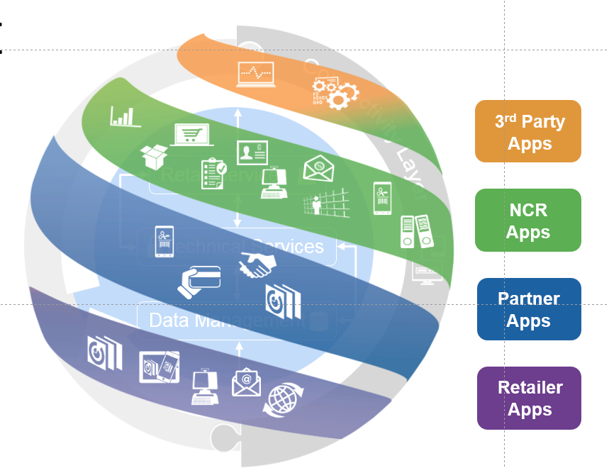







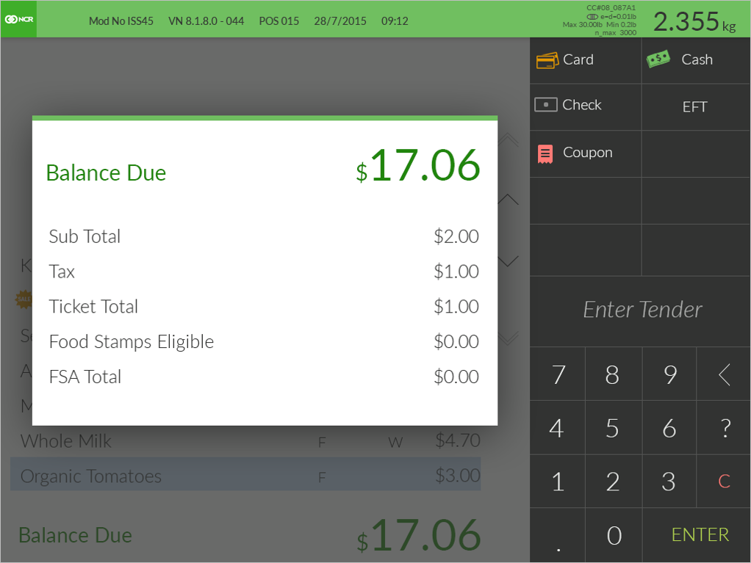
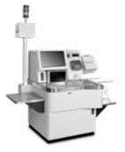


The Venue: ENCOR Architecture
Loyalty & Promotions
3rd Party
Apps
Loyalty and Promotions
NCR
Apps
Reports
Analytics
Partner
Apps
Digital
Coupons
SQL 2016
Digital
Receipts
Omni-Commerce Platform
Retailer
Apps
Master File Server and Workstations
NCR Cloud
Connected Payments
Connected Loyalty
POS Terminals and Self-Checkout
Connected Services
9
NCR Confidential

Slide 10
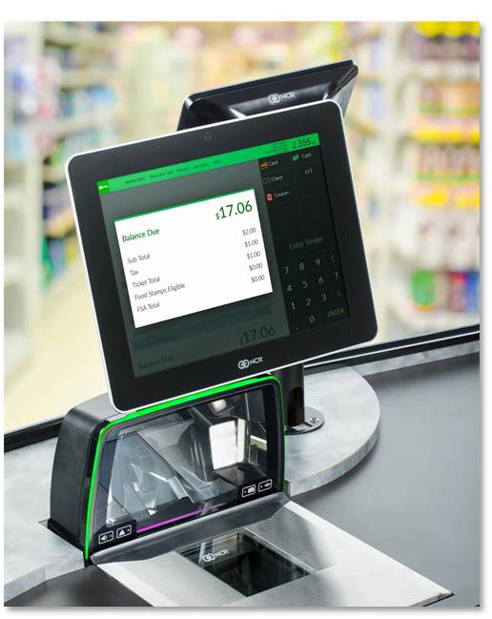
The Front Row:
ENCOR POS
ISS45’s reliability, with even more features and a superior look and feel
ENCOR’s modernized user interface uses familiar Windows 10 conventions
No additional training needed for ISS45 cashiers: The same operations apply
ENCOR offers an enhanced NCR DynaKey™ User Interface
  The migration of existing hardware with and full touch is supported
NCR Confidential
10

Slide 11
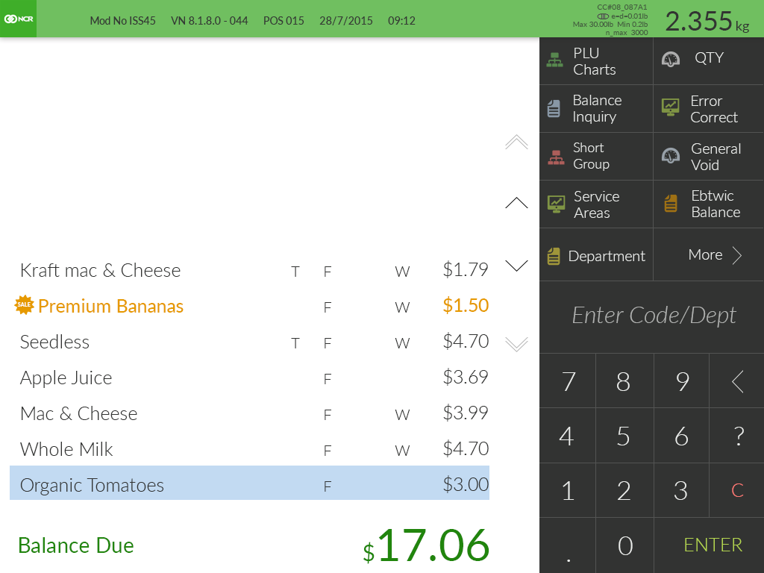
ENCOR 1.0.0.0
2.35 _{lbs.}

Slide 12

ENCOR 1.0.0.0
2.35 _{lbs.}

Slide 13
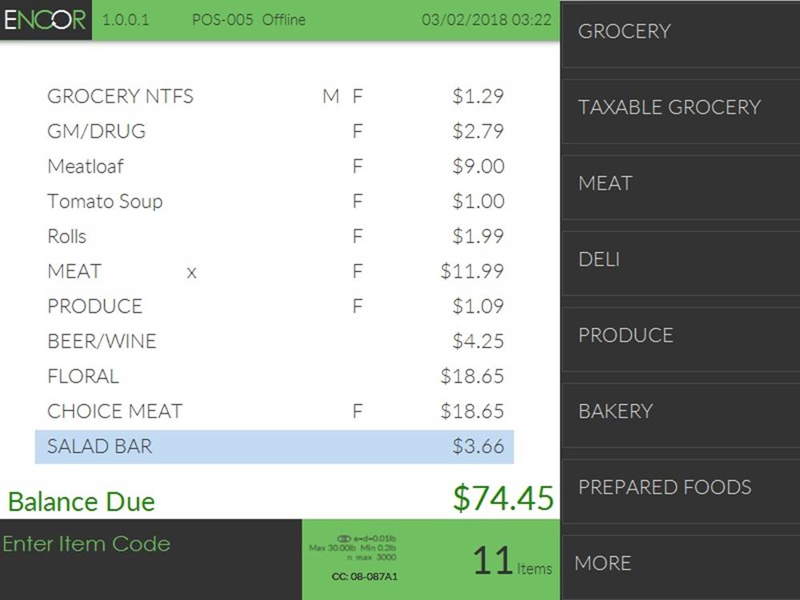

Slide 14
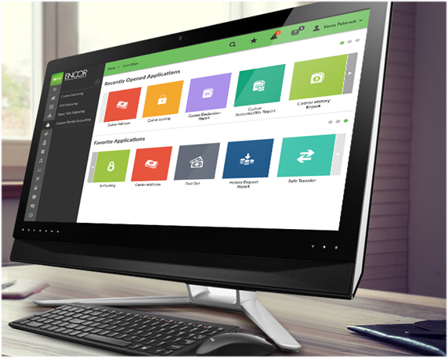
Back Stage:
Store Management
Operational efficiencies from ENCOR’s integrated front office/back office
Windows 10 UX
Integrated back office suite
Broader in-store / enterprise solution set
Contemporary, efficient navigation
User and roles management
Open architecture based on web API
NCR Confidential
14

Slide 15
Store Management…
Real-time POS management and monitoring
Complete item, department, category and vendor management
Electronic journal: real-time transaction processing
Powerful cash office and end-of-day processes
Versatile detailed reporting module
Extensive electronic import / export
DSD receiving and perpetual inventory control
Date, priority, quantity/weight-driven pricing models
NCR Confidential
15

Slide 16
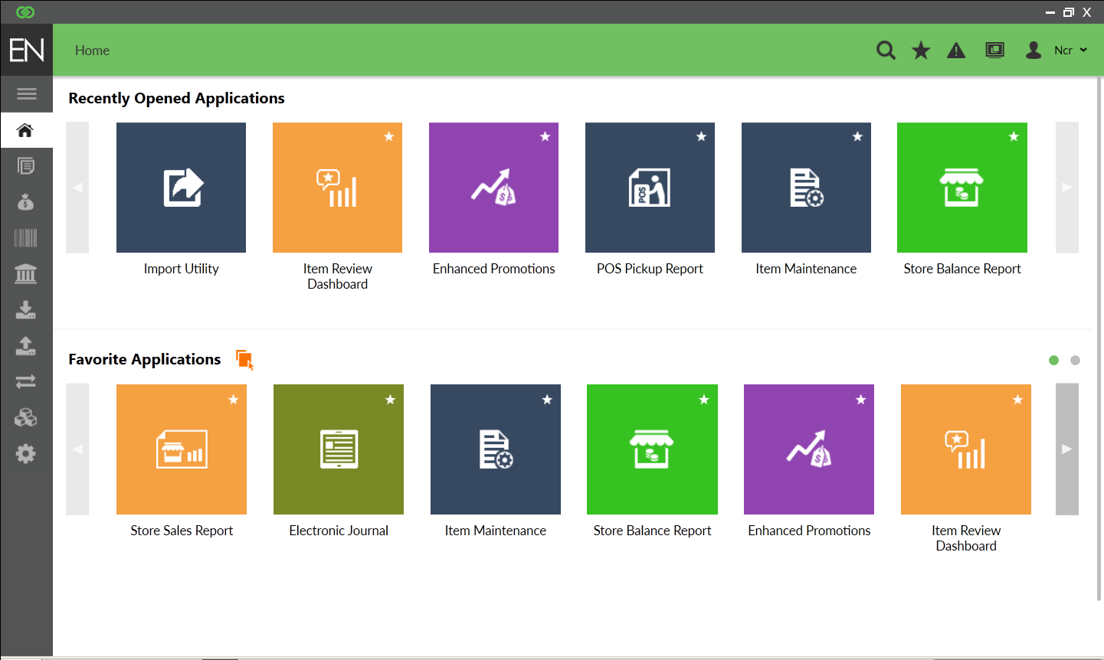

Slide 17
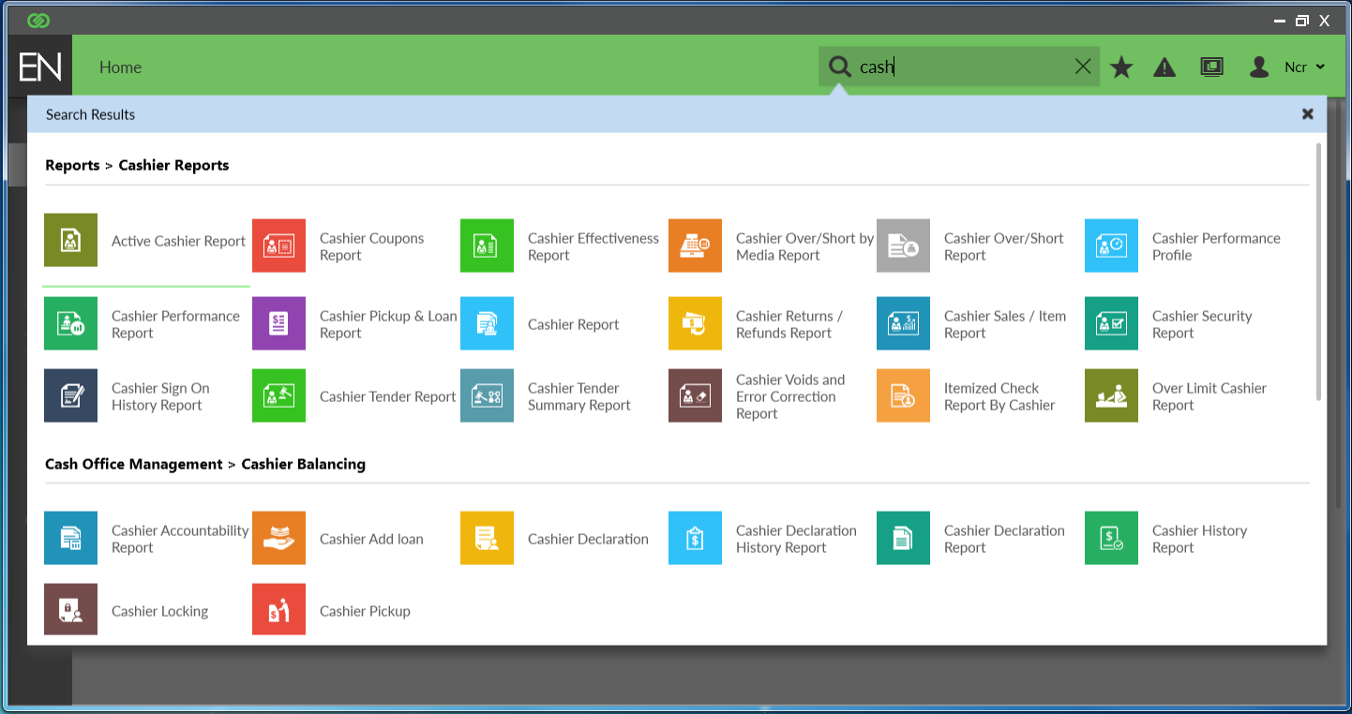

Slide 18
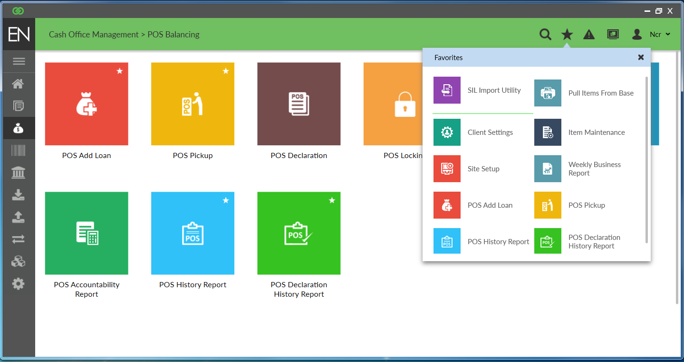

Slide 19

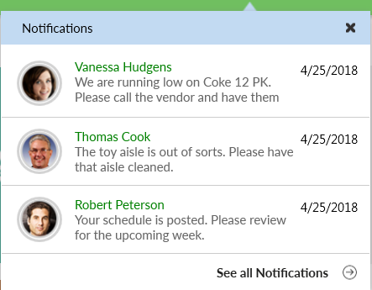

Slide 20
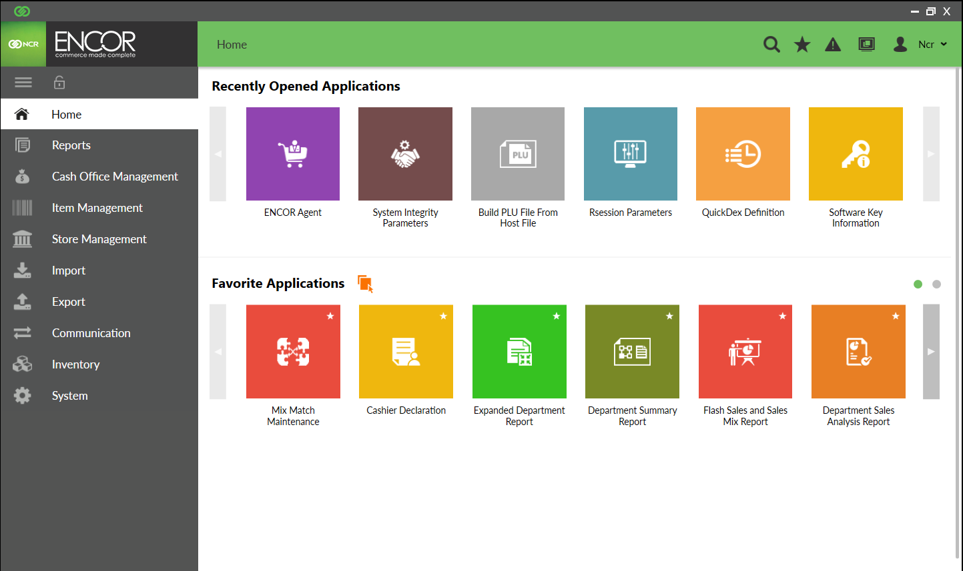

Slide 21
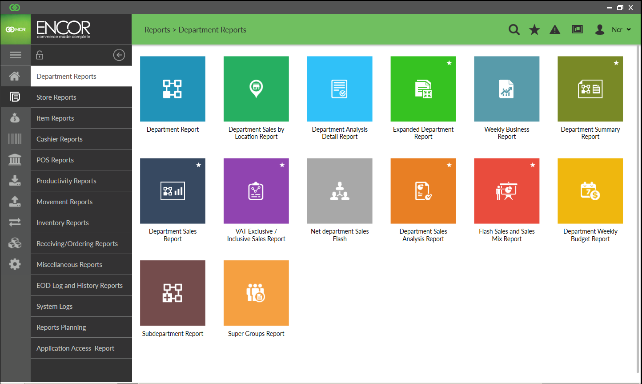

Slide 22






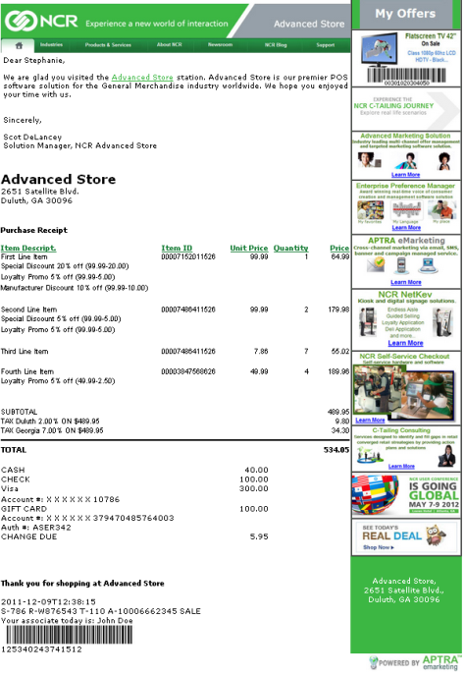





Playbill:
ENCOR’s
Complete
Solution
POS Hardware
Mobile
Dashboard
Kiosks
Self-Checkout (FastLane)
FastLane
Mobile
Shopper
C O M P L E M E N T A R Y
S O L U T I O N S
Fuel
Digital Receipts
Digital
Coupons
Loyalty and
Connected Loyalty
Power HQ, DAX and Inventory
Connected Services
ENCOR Enterprise
(ABO Central)
Connected Payments
NCR Confidential
22

Slide 23
ENCOR Platform and Extensions
Capabilities
R&D Investment: ENCOR is NCR go-forward for digital solutions, self-serve and mobile
Windows 10 UX / Web-enabled features
Platforms: Windows Server 2016, Windows 10, Windows 10 IoT (POS terminals)
Back Office: Integrated Hosting, DSD, inventory, Scale management, Label printing Native enterprise module (ENCOR/ABO Central)
Loyalty: NCR Loyalty Pro and Connected Loyalty
Fuel: Fully integrated ENCOR Fuel option
Mobile POS Retail-hardened tablet Bluetooth printer and hand-held scanner EMV payments Full POS functions (no scale items or cash tender)
Third-party integration: Comprehensive list of support for industry applications
NCR Confidential
23

Slide 24























The Main Stage:
NCR Omni-Commerce Platform and Open Ecosystem
Online
3rd Party
Apps
Tablet
Mobile
Retail Services
NCR
Apps
Consumer Touch Points
Technical Services
SaaS
POS
Partner
Apps
Data Management
Kiosk
Self Checkout
Retailer
Apps
NCR Confidential
24

Slide 25
NCR Platform Cloud-Level Details with ENCOR
Capabilities
NCR Cloud Platform Enabled – Open Digital Ecosystem Cloud Offerings – Digital Coupons & Receipts, Central Reports / Analytics / EJ / Returns Products in Cloud can Interact providing more Comprehensive Solutions Public APIs for Best in Class Solutions (NCR, 3rd Parties, Partners, Retailers)
Cloud Platform Digital Coupons Normalized API for 3rd party providers including Inmar Capability to interact with other Platform Apps such as Digital Receipts
Cloud Platform Digital Receipts Increase Consumer Loyalty – Green Initiative E-mail, SMS Text and Web Portal options Can interact with other Platform Apps such as Digital Coupon and Connected Loyalty
Central Reports / Cashier Analytics Real-time Enterprise View of Store Financials (Dashboards / Detail Drill Downs) Drill Down from Full Enterprise to Individual Transaction Track Cashier Performance / Vulnerabilities
NCR Confidential
25

Slide 26
Previews of Coming Attractions
 | IN CURRENT RELEASE | COMING SOON… | GETTING READY FOR PRIME TIME
RELEASE COMPONENTS | 1. ENCOR 1.0.1.0 | 1. ENCOR 1.0.2.0 | 1. ENCOR 1.0.3.0
CAPABILITIES | Complete stand-alone POS operations Integrated back office with exceptional price and batch management, DSD, perpetual and physical inventory, scale management and label printing Fully configurable with parameter driven functions Powerful customer engagement tools with promotions, surveys and email receipts Integrated fuel, enterprise loyalty and self-checkout Real-time transaction processing with searchable E/J All significant third-party interfaces are supported ABO Enterprise and NCR cloud platform-ready Windows 10, Server 2016 and SQL 2017 support Comprehensive financial reporting and enhanced A/R | POS on DLI Mobile Tablet, including EMV payments SSCO ADK 6.12 certification Financial Report: New comparative analytics Financial Report: New automated scheduler for export, print and email Windows 10 64-bit on POS terminals | NCR Platform integration -TDM 2.1 -Digital coupon -Enterprise-level receipts Smart-Card WIC: Version 4 Support Smart-Card WIC: CDP Host Support
CUSTOMER BENEFITS | Stable: Mature “out-of-box” deployment Proven: Huge installed base of 6700+ stores Scope: Delivers wide range of store-level applications Complete: Flexible, scalable and cloud-enabled Shopper experience: History of checkout speed and “never-down” availability System efficiency: And tools that optimize operations Security: Connected Payments protects shoppers and data | Provides retail-hardened mobile checkout for que-busting, curbside checkout and front-end overflow SSCO ADK 6.12 simplify purchases, cuts transaction time, reduces shrink and detects potential checkout fraud Enables better decisions using historic financial comparisons Ensures supported O/S and SQL versions | SaaS delivery of cloud solutions Dynamic offers and rewards Increased shopper loyalty Improved consumer experience with personalized rewards and choices for receipts – Email, SMS or Web Portal Green initiative Maintain UDSA-FNS/State gov’t compliance with all WIC programs
Note: The roadmap information shown on this slide is not a commitment, promise or legal obligation to deliver any product, software, or services. Timing and content of roadmap items are current as of the publication date of this roadmap, but are subject to change, and may be subject to geographic restrictions and technical and product pre-requisites as determined by NCR.
NCR Confidential
26

Slide 27
ENCOR Future Items: Details
Capabilities
Central Configuration Enable ENCOR configuration to be managed from enterprise level and sent to individual or groups of stores or entire enterprise
FastLane Mobile Shopping Shoppers scan product as they shop using their phone or supplied handheld Shoppers pay at FastLane pay station Coupons and loyalty / promotions applied Configurable trust levels and audit capability
Central Customer / Loyalty Lite Native ENCOR shopper and continuity data resides at enterprise level Enables shopper access to up-to-date information no matter which stores they shop
Central EJ / Returns Access transaction detail from any store within the enterprise Barcode on receipt retrieves transaction and returns at purchased pricing Returns are easy to handle at any of the stores regardless of original purchase site
Note: The roadmap information shown on this slide is not a commitment, promise or legal obligation to deliver any product, software, or services. Timing and content of roadmap items are current as of the publication date of this roadmap, but are subject to change, and may be subject to geographic restrictions and technical and product pre-requisites as determined by NCR.
NCR Confidential
27

Slide 28
ENCOR Future Items: Details
Capabilities
Cashier Messaging Enables message delivery to POS receipt printer and cashier / customer displays Messages delivered immediately, or can be triggered by events such as sign on/off, transaction start/finish, specific items purchased or departments scanned Messages can be one time or recurring Messages can be sent to individual cashiers or groups of cashiers or lanes
Multi-Media Management Easy and secure management of multi-media content on shopper display Automatically sequenced, or triggered by events such as department or item sales Revenue source from vendors and local business co-advertising
Command Center Powerful and secure remote management system Monitor ENCOR system for health (hardware / software) with alerts Perform remote diagnostics and firmware updates
Note: The roadmap information shown on this slide is not a commitment, promise or legal obligation to deliver any product, software, or services. Timing and content of roadmap items are current as of the publication date of this roadmap, but are subject to change, and may be subject to geographic restrictions and technical and product pre-requisites as determined by NCR.
NCR Confidential
28

Slide 29
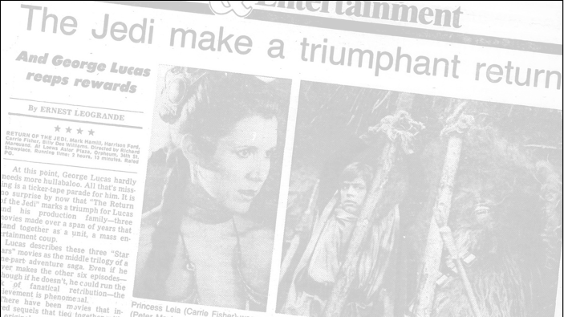
The Reviews are In!
“…If you buy just one POS system this season, make it THIS ONE…”
“…A fitting and satisfying sequel to a 25-year series of winners…”
“…A great [feature] set… this one has it ALL!”
“…So much flexibility for every scene … it turns out just how you want.”
“…Leave the pretenders alone … this one’s the real deal!
“…New and visually exciting — with no troubling plot twists…”
“…It starts strong and just keeps going — and going — and going.”
“…I’ve seen the future and this is IT!
“…You can trust this team: They always bring you the best.”
“…and talk about getting a happy ending: WOW!”
NCR Confidential
29

Slide 30
THANK YOU

